Slide 1

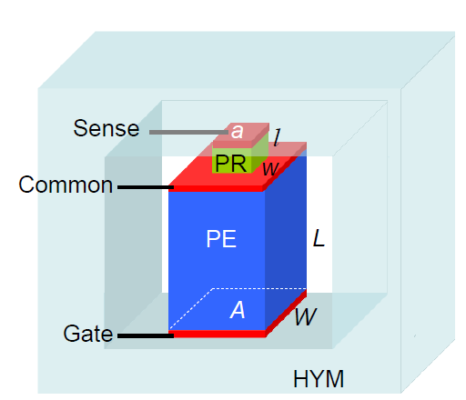
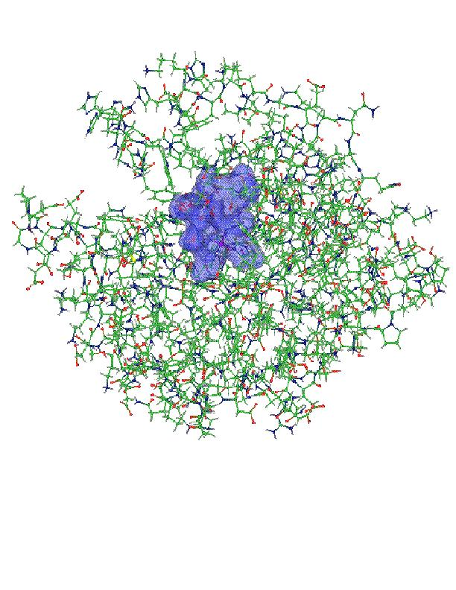
Projector Augmented Wave based
Kohn-Sham Density Functional Theory in OpenAtom with N² log N scaling
Qi Li, Eric Bohm,
and Glenn Martyna

Slide 2
Introduction to the Projector Augmented Wave (PAW) method

Slide 3
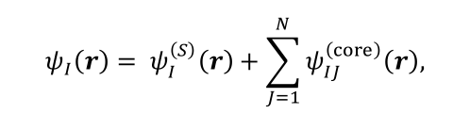
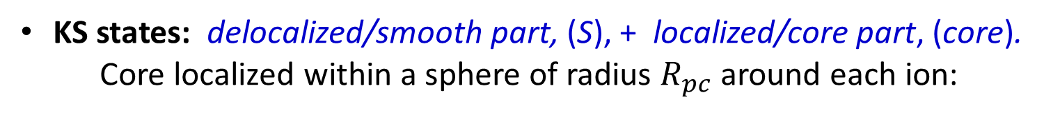
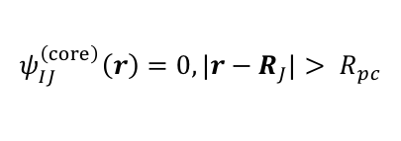
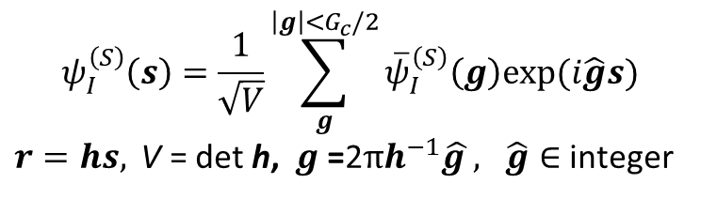
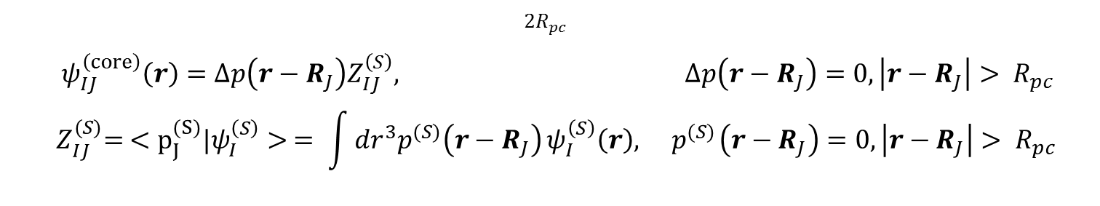

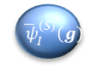
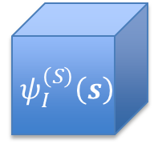
PAW Basics: KS states
KS states: delocalized/smooth part, (S), + localized/core part, (core). Core localized within a sphere of radius $R_{pc}$ around each ion:
$$ψ_{I}\left(r\right)= ψ_{I}^{\left(S\right)}\left(r\right)+\sum_{J=1}^{N}{ψ_{IJ}^{\left(core\right)}\left(r\right),}$$
$$ψ_{IJ}^{\left(core\right)}\left(r\right)=0, |r−R_{J}|> R_{pc}$$
Smooth: fills all spaces & varies, expanded in plane-waves:
$$ψ_{I}^{\left(S\right)}\left(s\right)=\frac{1}{\sqrt{V}}\sum_{g}^{\left|g\right|<G_{c}/2}{{\overline{ψ}}_{I}^{\left(S\right)}\left(g\right)exp⁡(i\hat{g}s)}$$ $r=hs, \text{V}\text{ = }\text{det} \text{h}\text{, } g\text{ =}\text{2}πh^{−1}\hat{g }, \hat{g}∈$ integer
$${ ψ}_{I}^{\left(S\right)}\left(s\right)$$
$${ \overline{ ψ}}_{I}^{\left(S\right)}\left(g\right)$$
Core: localized, written in terms of fixed core projectors, ${\left\{Δp{,p}^{(S)}\right\}}^{∗}:$
$${2R}_{pc}$$
$ψ_{IJ}^{\left(core\right)}\left(r\right)=Δp\left(r−R_{J}\right)Z_{IJ}^{\left(S\right)}, Δp\left(r−R_{J}\right)=0, \left|r−R_{J}\right|> R_{pc}$ $${ Z}_{IJ}^{(S)}= <p_{J}^{(S)}{|ψ}_{I}^{\left(S\right)}> = \int{{dr}^{3}p^{(S)}\left(r−R_{J}\right)}ψ_{I}^{\left(S\right)}\left(r\right),{ p}^{(S)}\left(r−R_{J}\right)=0, \left|r−R_{J}\right|> R_{pc}$$
$∗1 ion type, 1 channel$ for simplicity

Slide 4
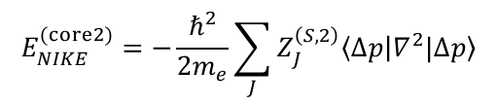
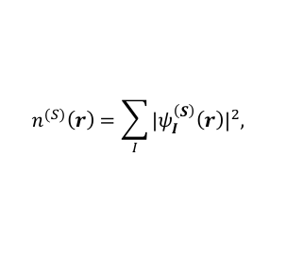
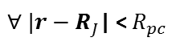
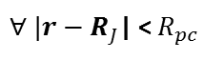
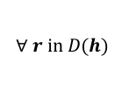
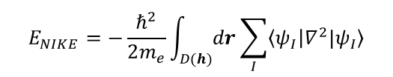
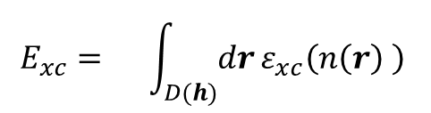
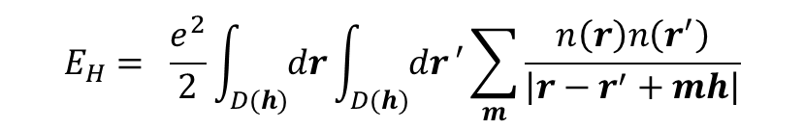
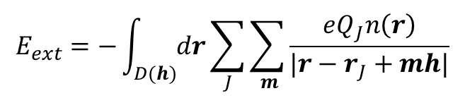
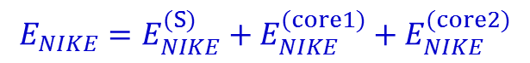
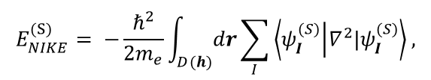
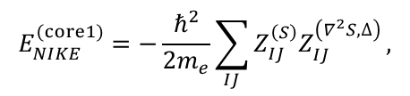
PAW Basics: KS-DFT within LDA under
periodic boundary conditions at Γ
The whole enchilada:
$$E\left[n\left(r\right)\right]=E_{NIKE}+E_{ext}+E_{H}+E_{xc}$$
$$E_{NIKE}=−\frac{ℏ^{2}}{2m_{e}}\int_{D(h)}{dr}\sum_{I}{\left\langle ψ_{I} | ∇^{2}{|ψ}_{I}\right\rangle }$$
$$E_{xc}= \int_{D(h)}{dr}ε_{xc}\left(n\left(r\right) \right)$$
$$E_{H}= \frac{e^{2}}{2}\int_{D(h)}{dr}\int_{D(h)}{dr}′\sum_{m}{\frac{n\left(r\right)n\left(r^{′}\right)}{\left|r−r^{′}+mh\right|}}$$
$$E_{ext}=−\int_{D(h)}{dr}\sum_{J}{\sum_{ m}{\frac{eQ_{J}n\left(r\right)}{|r−r_{J}+mh|}}}$$
Non-interacting electron kinetic energy: Smooth and core terms
$$E_{NIKE}=E_{NIKE}^{(S)}+E_{NIKE}^{(core1)}{+ E}_{NIKE}^{(core2)}$$
$$E_{NIKE}^{(S)}= −\frac{ℏ^{2}}{2m_{e}}\int_{D(h)}{dr}\sum_{I}{\left\langle ψ_{I}^{(S)} | ∇^{2}|ψ_{I}^{(S)}\right\rangle ,}$$
$$E_{NIKE}^{(core1)}=−\frac{ℏ^{2}}{2m_{e}}\sum_{IJ}{Z_{IJ}^{\left(S\right)}Z_{IJ}^{\left(∇^{2}S,∆\right)}},$$
$$E_{NIKE}^{(core2)}=−\frac{ℏ^{2}}{2m_{e}}\sum_{J}{Z_{J}^{\left(S,2\right)}\left\langle ∆p | ∇^{2}|∆p\right\rangle }$$
Exchange Correlation energy: Smooth and core terms
Jth core
$$E_{xc}=E_{xc}^{(S)}+E_{xc}^{(core)}=\int_{D(h)}{dr}ε_{xc}\left(n^{(S)}\left(r\right) \right)+ \sum_{J}{\int_{D(R_{pc})}{dr}}\left[ε_{xc}\left(n_{J}\left(r\right) \right)−ε_{xc}\left(n_{J}^{(S)}\left(r\right)\right)\right]$$
$$n^{(S)}\left(r\right)=\sum_{I}{{{|ψ}_{I}^{\left(S\right)}\left(r\right)|}^{2}, }$$
$n_{J}\left(r\right)=n^{(S)}\left(r−R_{J}\right)+n^{(core1)}\left(r−R_{J}\right)$ + $n^{(core2)}\left(r−R_{J}\right)$, ${ n}_{J}^{(S)}\left(r\right)=n^{(S)}\left(r−R_{J}\right)$
$$∀ r in D(h)$$
$∀ |r−R_{J}$| <${ R}_{pc}$
$∀ |r−R_{J}$| <${ R}_{pc}$

Slide 5
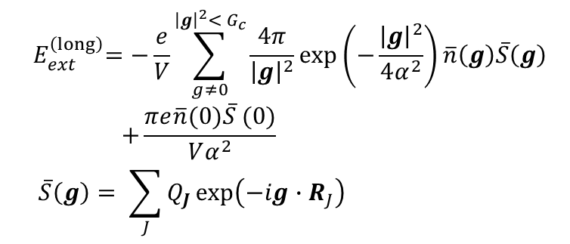
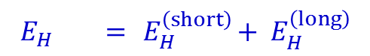
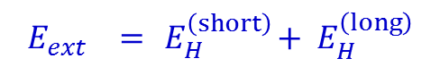
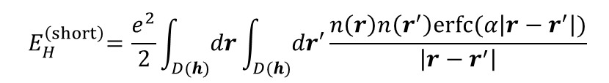
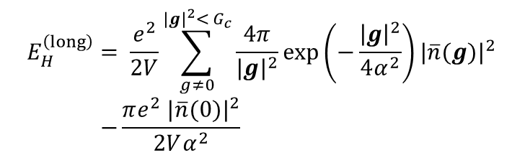
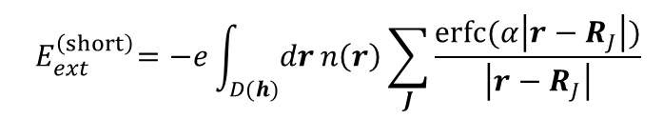
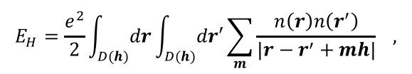
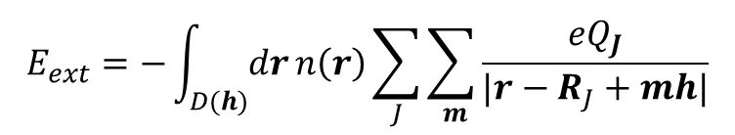
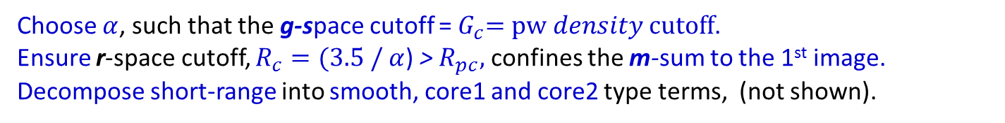
PAW Basics: KS-DFT long/short-range decomposition
Due to the mixed localized and delocalized basis, there is no natural truncation scale
for the long-range interactions of E_{H} and E_{ext} in g-space or r-space alone.
$$E_{H}=\frac{e^{2}}{2}\int_{D(h)}{dr}\int_{D(h)}{dr′}\sum_{m}{\frac{n\left(r\right)n\left(r^{′}\right)}{\left|r−r^{′}+mh\right|}} ,$$
$$E_{ext}=−\int_{D(h)}{dr}n\left(r\right)\sum_{J}{\sum_{ m}{\frac{{eQ}_{J}}{|r−R_{J}+mh|}}}$$
Using Poisson summation and Ewald’s decomposition of 1/r:
$$E_{H} ={ E}_{H}^{\left(short\right)}+{ E}_{H}^{\left(long\right)}$$
$$E_{ext} ={ E}_{H}^{\left(short\right)}+{ E}_{H}^{\left(long\right)}$$
$${ E}_{H}^{\left(short\right)}=\frac{e^{2}}{2}\int_{D(h)}{dr}\int_{D(h)}{dr′}\frac{n\left(r\right)n\left(r^{′}\right)erfc⁡(α\left|r−r^{′}\right|)}{\left|r−r^{′}\right|}$$
$${ E}_{ext}^{\left(short\right)}=−e\int_{D(h)}{dr}n\left(r\right)\sum_{J}{\frac{erfc⁡(α\left|r−R_{J}\right|)}{\left|r−R_{J}\right|}}$$
$${ E}_{H}^{\left(long\right)} = \frac{e^{2}}{2V}\sum_{g≠0}^{{|g|}^{2}<{ G}_{c}}{\frac{4π}{{|g|}^{2}}}exp\left(−\frac{{\left|g\right|}^{2}}{4α^{2}}\right){|\overline{n}(g)|}^{2} \\ −\frac{πe^{2} {|\overline{n}(0)|}^{2}}{2Vα^{2}}$$
$${ E}_{ext}^{\left(long\right)}=−\frac{e}{V}\sum_{g≠0}^{{\left|g\right|}^{2}<{ G}_{c}}{\frac{4π}{{\left|g\right|}^{2}}}exp\left(−\frac{{\left|g\right|}^{2}}{4α^{2}}\right)\overline{n}\left(g\right)\overline{S}\left(g\right) \\ +\frac{πe\overline{n}(0)\overline{S} (0)}{Vα^{2}} \\ \overline{S}\left(g\right)= \sum_{J}{Q_{J}}exp⁡\left(−ig∙R_{J}\right)$$
Choose $α$, such that the g-space cutoff =${ G}_{c}=pw density cutoff$.
Ensure r-space cutoff, $R_{c}=(3.5 /$ $α$) > $R_{pc},$ confines the m-sum to the 1st image.
Decompose short-range into smooth, core1 and core2 type terms, (not shown).

Slide 6







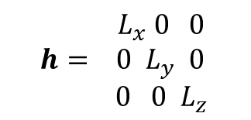
PAW Basics: Example KS state
$${ L}_{x} 0 0$$
$${h= 0 L}_{y} 0$$ ${ 0 0 L}_{z}$
Localized ion core states, $ψ_{IJ}^{\left(core\right)}\left(r\right)$embedded
$$ψ_{I,1}^{\left(core\right)}\left(r\right)$$
$$ψ_{I,2}^{\left(core\right)}\left(r\right)$$
$$L_{z}$$
$$ψ_{I}^{\left(S\right)}(r)$$
$$L_{y}$$
$$L_{x}$$
in the smooth part of the state, $ψ_{I}^{\left(S\right)}\left(r\right),$that fills D(h).

Slide 7
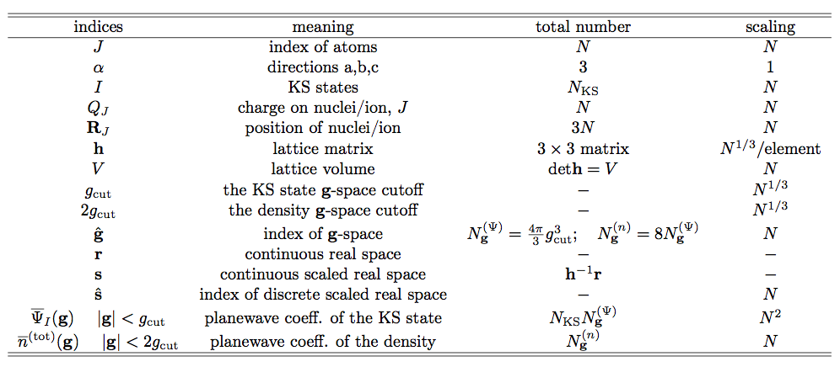
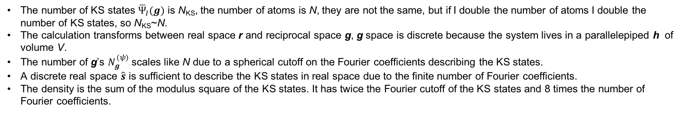
Definitions
The number of KS states ${\overline{Ψ}}_{I}(g)$ is N_{KS}, the number of atoms is N, they are not the same, but if I double the number of atoms I double the number of KS states, so N_{KS}~N.
The calculation transforms between real space r and reciprocal space g, g space is discrete because the system lives in a parallelepiped h of volume V.
The number of g’s $N_{g}^{(ψ)}$ scales like N due to a spherical cutoff on the Fourier coefficients describing the KS states.
A discrete real space $\hat{s}$ is sufficient to describe the KS states in real space due to the finite number of Fourier coefficients.
The density is the sum of the modulus square of the KS states. It has twice the Fourier cutoff of the KS states and 8 times the number of Fourier coefficients.

Slide 8
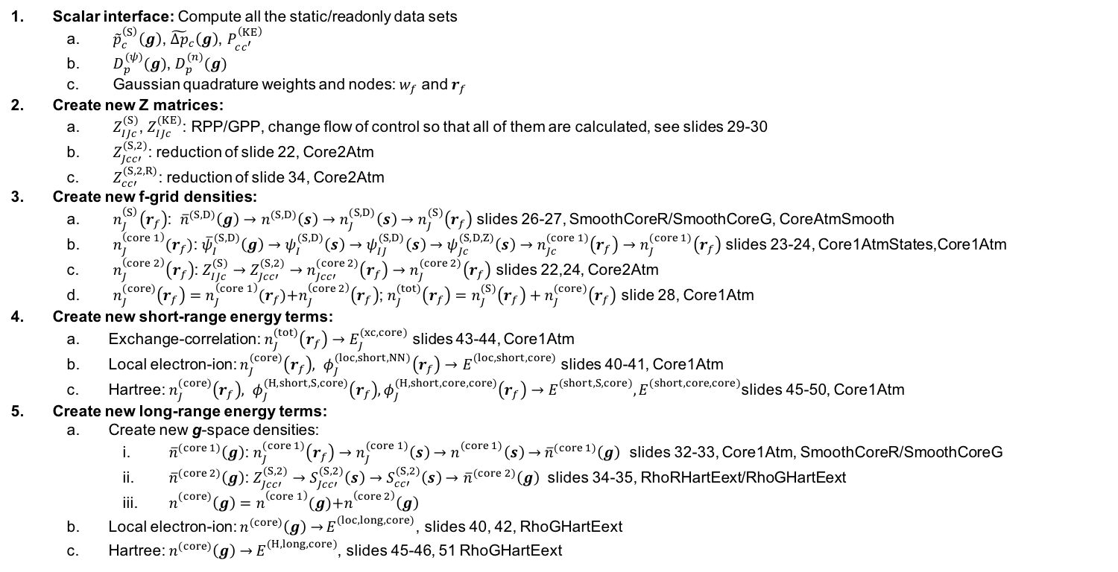
Weird Physics stuff that will show up later
Scalar interface: Compute all the static/readonly data sets
${\tilde{p}}_{c}^{\left(S\right)}\left(g\right)$, ${\tilde{∆p}}_{c}\left(g\right)$, $P_{cc^{′}}^{\left(KE\right)}$
$D_{p}^{(ψ)}(g)$, $D_{p}^{(n)}(g)$
Gaussian quadrature weights and nodes: $w_{f}$ and $r_{f}$
Create new Z matrices:
$Z_{IJc}^{(S)}$, $Z_{IJc}^{(KE)}$: RPP/GPP, change flow of control so that all of them are calculated, see slides 29-30
$Z_{Jcc′}^{(S,2)}$: reduction of slide 22, Core2Atm
$Z_{cc′}^{(S,2, R)}$: reduction of slide 34, Core2Atm
Create new f-grid densities:
$n_{J}^{\left(S\right)}\left(r_{f}\right)$: ${\overline{n}}^{(S,D)}\left(g\right)→n^{(S,D)}\left(s\right)→n_{J}^{(S,D)}\left(s\right)→n_{J}^{(S)}\left(r_{f}\right)$slides 26-27, SmoothCoreR/SmoothCoreG, CoreAtmSmooth
$n_{J}^{\left(core 1\right)}(r_{f})$: ${\overline{ψ}}_{I}^{(S,D)}\left(g\right)→ψ_{I}^{(S,D)}\left(s\right)→ψ_{IJ}^{(S,D)}\left(s\right)→ψ_{Jc}^{(S,D,Z)}\left(s\right)→n_{Jc}^{(core 1)}\left(r_{f}\right)→n_{J}^{(core 1)}\left(r_{f}\right)$ slides 23-24, Core1AtmStates,Core1Atm
$n_{J}^{\left(core 2\right)}\left(r_{f}\right)$: $Z_{IJc}^{(S)}$ $→Z_{Jcc′}^{(S,2)}→n_{Jcc′}^{(core 2)}\left(r_{f}\right)→n_{J}^{(core 2)}\left(r_{f}\right)$ slides 22,24, Core2Atm
$n_{J}^{(core)}\left(r_{f}\right)=n_{J}^{\left(core 1\right)}(r_{f})\text{+}n_{J}^{\left(core 2\right)}\left(r_{f}\right)$; $n_{J}^{(tot)}\left(r_{f}\right)=n_{J}^{(S)}\left(r_{f}\right)+n_{J}^{(core)}\left(r_{f}\right)$ slide 28, Core1Atm
Create new short-range energy terms:
Exchange-correlation: $n_{J}^{(tot)}\left(r_{f}\right)→E_{J}^{(xc,core)}$ slides 43-44, Core1Atm
Local electron-ion: $n_{J}^{(core)}\left(r_{f}\right), φ_{J}^{(loc,short,NN)}\left(r_{f}\right)→E_{}^{(loc,short,core)}$ slides 40-41, Core1Atm
Hartree: $n_{J}^{(core)}\left(r_{f}\right), φ_{J}^{(H,short,S,core)}\left(r_{f}\right),φ_{J}^{(H,short,core,core)}\left(r_{f}\right)→E_{}^{(short,S,core)},E_{}^{(short,core,core)}$slides 45-50, Core1Atm
Create new long-range energy terms:
Create new g-space densities:
${\overline{n}}^{(core 1)}\left(g\right)$: $n_{J}^{(core 1)}\left(r_{f}\right)→n_{J}^{(core 1)}\left(s\right)$ $→n_{}^{(core 1)}\left(s\right)$ $→$ ${\overline{n}}^{(core 1)}\left(g\right)$ slides 32-33, Core1Atm, SmoothCoreR/SmoothCoreG
${\overline{n}}^{(core 2)}\left(g\right)$: $Z_{Jcc′}^{(S,2)}→S_{Jcc′}^{(S,2)}\left(s\right)→S_{cc′}^{(S,2)}\left(s\right)→$ ${\overline{n}}^{(core 2)}\left(g\right)$ slides 34-35, RhoRHartEext/RhoGHartEext
$n_{}^{(core)}\left(g\right)=n_{}^{\left(core 1\right)}(g)\text{+}n_{}^{\left(core 2\right)}\left(g\right)$
Local electron-ion: $n^{(core)}\left(g\right)$ $→$ $E_{}^{(loc,long,core)}$, slides 40, 42, RhoGHartEext
Hartree: $n^{(core)}\left(g\right)$ $→$ $E_{}^{(H,long,core)}$, slides 45-46, 51 RhoGHartEext

Slide 9
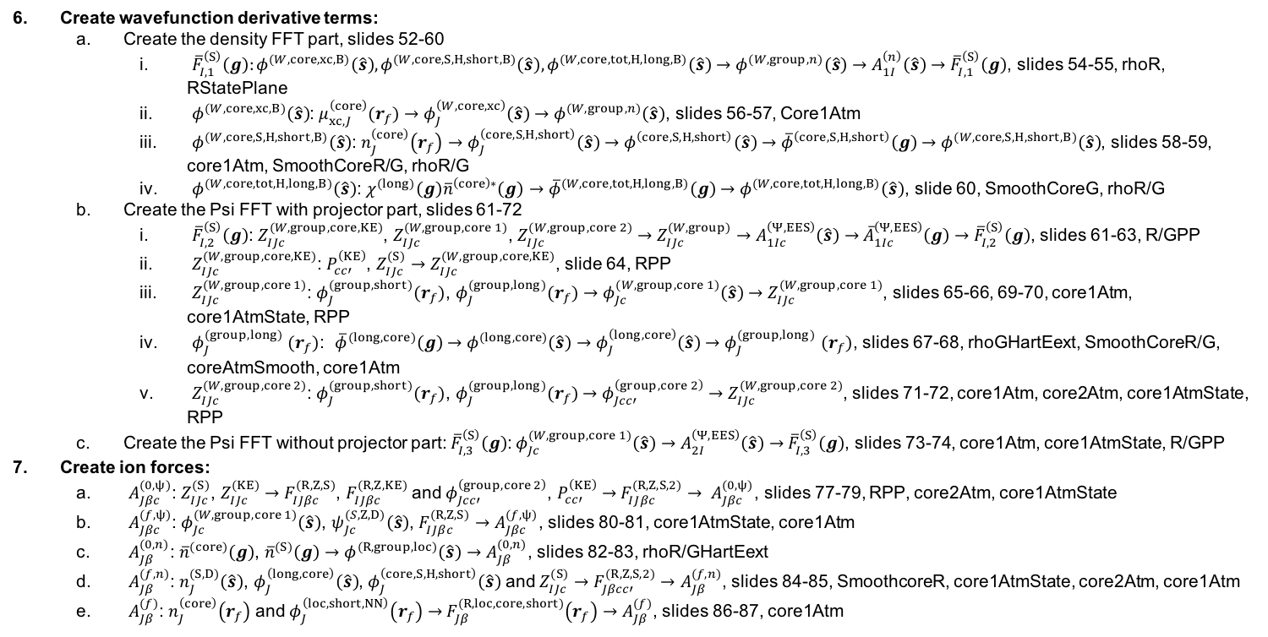
Weird Physics stuff that will show up later.
Create wavefunction derivative terms:
Create the density FFT part, slides 52-60
${\overline{F}}_{I,1}^{\left(S\right)}\left(g\right):φ^{(W,core,xc,B)}\left(\hat{s}\right),φ^{(W,core,S,H,short,B)}\left(\hat{s}\right),φ^{(W,core,tot,H,long,B)}\left(\hat{s}\right)→φ^{(W,group,n)}\left(\hat{s}\right)→A_{1I}^{\left(n\right)}\left(\hat{s}\right)$ $→$ ${\overline{F}}_{I,1}^{\left(S\right)}\left(g\right)$, slides 54-55, rhoR, RStatePlane
$φ^{(W,core,xc,B)}\left(\hat{s}\right)$: $μ_{xc,J}^{\left(core\right)}(r_{f})$ $→$ $φ_{J}^{\left(W,core,xc\right)}\left(\hat{s}\right)$ $→$ $φ^{(W,group,n)}\left(\hat{s}\right)$, slides 56-57, Core1Atm
$φ^{(W,core,S,H,short,B)}\left(\hat{s}\right)$: $n_{J}^{\left(core\right)}\left(r_{f}\right)$ $→$ $φ_{J}^{\left(core,S,H,short\right)}\left(\hat{s}\right)$ $→$ $φ^{\left(core,S,H,short\right)}\left(\hat{s}\right)$ $→$ ${\overline{φ}}^{\left(core,S,H,short\right)}\left(g\right)$ $→φ^{(W,core,S,H,short,B)}\left(\hat{s}\right)$, slides 58-59, core1Atm, SmoothCoreR/G, rhoR/G
$φ^{(W,core,tot,H,long,B)}\left(\hat{s}\right)$: ${χ^{(long)}\left(g\right)\overline{n}}^{\left(core\right)∗}\left(g\right)$ $→$ ${\overline{φ}}^{(W,core,tot,H,long,B)}\left(g\right)$ $→$ $φ^{(W,core,tot,H,long,B)}\left(\hat{s}\right)$, slide 60, SmoothCoreG, rhoR/G
Create the Psi FFT with projector part, slides 61-72
${\overline{F}}_{I,2}^{\left(S\right)}\left(g\right)$: $Z_{IJc}^{(W,group, core,KE)}$, $Z_{IJc}^{(W,group, core 1)}$, $Z_{IJc}^{(W,group, core 2)}$ $→$ $Z_{IJc}^{(W,group)}$ $→$ $A_{1Ic}^{\left(Ψ,EES\right)}\left(\hat{s}\right)$ $→$ ${\overline{A}}_{1Ic}^{\left(Ψ,EES\right)}\left(g\right)$ $→$ ${\overline{F}}_{I,2}^{\left(S\right)}\left(g\right)$, slides 61-63, R/GPP
$Z_{IJc}^{(W,group, core,KE)}$: $P_{cc′}^{\left(KE\right)}$, $Z_{IJc}^{(S)}→Z_{IJc}^{(W,group, core,KE)}$, slide 64, RPP
$Z_{IJc}^{(W,group, core 1)}$: $φ_{J}^{(group,short)}(r_{f})$, $φ_{J}^{(group,long)}(r_{f})→$ $φ_{Jc}^{(W,group,core 1)}\left(\hat{s}\right)→$ $Z_{IJc}^{(W,group, core 1)}$, slides 65-66, 69-70, core1Atm, core1AtmState, RPP
$φ_{J}^{(group,long)}$ $(r_{f})$: ${\overline{φ}}^{(long,core)}\left(g\right)$ $→$ $φ^{(long,core)}\left(\hat{s}\right)$ $→$ $φ_{J}^{\left(long,core\right)}\left(\hat{s}\right)$ $→$ $φ_{J}^{(group,long)}$ $(r_{f})$, slides 67-68, rhoGHartEext, SmoothCoreR/G, coreAtmSmooth, core1Atm
$Z_{IJc}^{(W,group, core 2)}$: $φ_{J}^{(group,short)}(r_{f})$, $φ_{J}^{(group,long)}(r_{f})$ $→$ $φ_{Jcc′}^{\left(group,core 2\right)}$ $→$ $Z_{IJc}^{(W,group, core 2)}$, slides 71-72, core1Atm, core2Atm, core1AtmState, RPP
Create the Psi FFT without projector part: ${\overline{F}}_{I,3}^{\left(S\right)}\left(g\right)$: $φ_{Jc}^{(W,group,core 1)}\left(\hat{s}\right)$ $→$ $A_{2I}^{\left(Ψ,EES\right)}\left(\hat{s}\right)$ $→$ ${\overline{F}}_{I,3}^{\left(S\right)}\left(g\right)$, slides 73-74, core1Atm, core1AtmState, R/GPP
Create ion forces:
$A_{Jβc}^{(0,ψ)}$: $Z_{IJc}^{(S)}$, $Z_{IJc}^{(KE)}$ $→$ $F_{IJβc}^{(R,Z,S)}$, $F_{IJβc}^{(R,Z,KE)}$ and $φ_{Jcc′}^{\left(group,core 2\right)}$, $P_{cc′}^{\left(KE\right)}$ $→$ $F_{IJβc}^{(R,Z,S,2)}$ $→$ $A_{Jβc}^{(0,ψ)}$, slides 77-79, RPP, core2Atm, core1AtmState
$A_{Jβc}^{(f,ψ)}$: $φ_{Jc}^{(W,group,core 1)}\left(\hat{s}\right)$, $ψ_{Jc}^{(S,Z,D)}\left(\hat{s}\right)$, $F_{IJβc}^{(R,Z,S)}$ $→A_{Jβc}^{(f,ψ)}$, slides 80-81, core1AtmState, core1Atm
$A_{Jβ}^{(0,n)}$: ${\overline{n}}^{(core)}\left(g\right)$, ${\overline{n}}^{(S)}\left(g\right)$ $→$ $φ^{(R,group,loc)}\left(\hat{s}\right)$ $→A_{Jβ}^{(0,n)}$, slides 82-83, rhoR/GHartEext
$A_{Jβ}^{(f,n)}$: $n_{J}^{(S,D)}\left(\hat{s}\right)$, $φ_{J}^{\left(long,core\right)}\left(\hat{s}\right)$, $φ_{J}^{\left(core,S,H,short\right)}\left(\hat{s}\right)$ and $Z_{IJc}^{(S)}→$ $F_{Jβcc′}^{(R,Z,S,2)}→A_{Jβ}^{(f,n)}$, slides 84-85, SmoothcoreR, core1AtmState, core2Atm, core1Atm
$A_{Jβ}^{(f)}$: $n_{J}^{\left(core\right)}\left(r_{f}\right)$ and $φ_{J}^{\left(loc,short,NN\right)}\left(r_{f}\right)$ $→$ $F_{Jβ}^{(R,loc,core,short)}\left(r_{f}\right)$ $→$ $A_{Jβ}^{(f)}$, slides 86-87, core1Atm

Slide 10
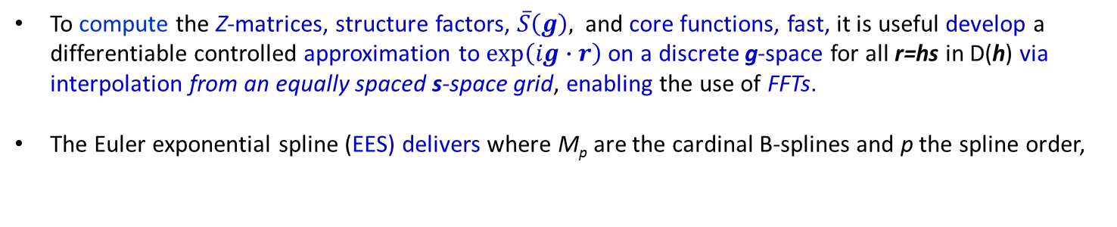
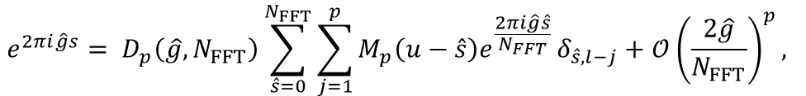
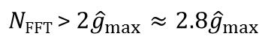
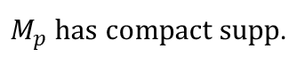
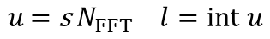
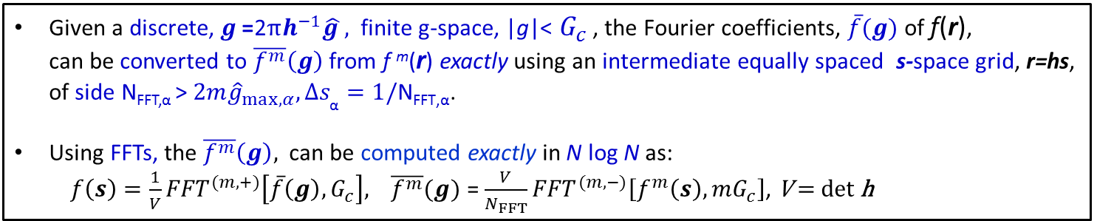
PAW Basics: Multi-Resolution, Grids, EES and N² log N scaling
How do we reduce scaling by one order in N and maintain accuracy?
1. Discrete real-space: Fourier Coefficients and FFTs
Given a discrete, $g\text{ =}\text{2}πh^{−1}\hat{g },$ finite g-space, |g|< $G_{c}$ , the Fourier coefficients, $\overline{f}(g)$ of f(r), can be converted to $\overline{f^{m}}\left(g\right)$ from f ^{m}(r) exactly using an intermediate equally spaced s-space grid, r=hs, of side N_{FFT,α} > $2m{\hat{g}}_{max,α}, ∆s_{\text{α}}=1/\text{N}\text{FFT}\text{,}\text{α}$.
Using FFTs, the $\overline{f^{m}}\left(g\right),$ can be computed exactly in N log N as:
$f\left(s\right)={\frac{1}{V}FFT}^{(m,+)}\left[\overline{f}\left(g\right),G_{c}\right],$ $\overline{f^{m}}(g)$ = ${\frac{V}{N_{FFT}}FFT}^{(m,−)}\left[f^{m}\left(s\right), mG_{c}\right]$, $\text{V}\text{ = }\text{det} \text{h}$
2. Euler Exponential Spline Interpolation and FFTs
To compute the Z-matrices, structure factors, $\overline{S}\left(g\right),$ and core functions, fast, it is useful develop a differentiable controlled approximation to $exp\left(ig∙r\right)$ on a discrete g-space for all r=hs in D(h) via interpolation from an equally spaced s-space grid, enabling the use of FFTs.
The Euler exponential spline (EES) delivers where M_{p} are the cardinal B-splines and p the spline order,
$$e^{2πi\hat{g}s}= D_{p}\left(\hat{g},N_{FFT}\right)\sum_{\hat{s}=0}^{N_{FFT}}{\sum_{j=1}^{p}{M_{p}\left(u−\hat{s}\right)e^{\frac{2πi\hat{g}\hat{s}}{N_{FFT}} }δ_{\hat{s},l−j}}}+𝒪{\left(\frac{2\hat{g}}{N_{FFT}}\right)}^{p},$$
$M_{p}$ has compact supp.
$$u\text{ = }\text{s} N_{FFT} l=int u$$
$$\text{N}\text{FFT}\text{ > }2{\hat{g}}_{max}≈2.8{\hat{g}}_{max}$$
Using 3 FFT grids, (1) Psi EES, (2) Density, (3) Density EES, and 1 discrete spherical polar grid around each ion, |r|<R_{pc} , all PAW
energy terms & their derivatives can be accurately computed in N² log N .

Slide 11
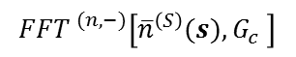




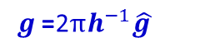
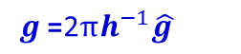
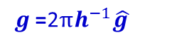
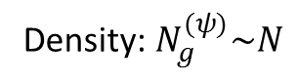
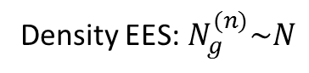
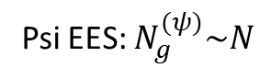
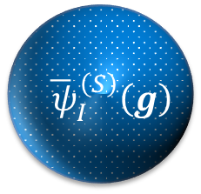
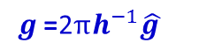























PAW Basics: g-space to s-space and back
Psi EES: $N_{g}^{(ψ)}\sim N$
Density:${ N}_{g}^{(ψ)}\sim N$
Density:${ N}_{g}^{(n)}\sim N$
Density EES:${ N}_{g}^{(n)}\sim N$
$${ \overline{ ψ}}_{I}^{\left(S\right)}\left(g\right)$$
$${\overline{n}}^{(S)}\left(g\right)$$
$${\overline{n}}^{(S)}\left(g\right)$$
$${ \overline{ψ}}_{I}^{\left(S\right)}\left(g\right)$$
$$g\text{ =}\text{2}πh^{−1}\hat{g }$$
$$g\text{ =}\text{2}πh^{−1}\hat{g }$$
$$g\text{ =}\text{2}πh^{−1}\hat{g }$$
$$g\text{ =}\text{2}πh^{−1}\hat{g }$$
$${\overline{ψ}}_{I}^{(S,D)}\left(g\right)={\overline{ψ}}_{I}^{\left(S\right)}\left(g\right)D^{(ψ)}(g)$$
${\overline{n}}^{\left(S,D\right)}(g)={\overline{n}}^{\left(S\right)}(g)D^{(n)}$ $(g$)
$${FFT }^{(ψ,+,EES)}\left[{\overline{ψ}}_{I}^{(S)}\left(g\right),\frac{G_{ }}{2}\right]$$
$${FFT }^{(n,−)}\left[{{\overline{n}}^{\left(S\right)}(s),G}_{c} \right]$$
$${FFT }^{(ψ,+,EES)}\left[{\overline{ψ}}_{I}^{(S,D)}\left(g\right),\frac{G_{ }}{2}\right]$$
$$\frac{V}{N_{FFT}^{(n)}}$$
$${FFT }^{(n,+,EES)}\left[{{\overline{n}}^{\left(S,D\right)}(g),G}_{c} \right]$$
$$\sqrt{V}$$
Psi: $N_{FFT}^{(ψ,EES)}\sim N$
Density: $N_{FFT}^{(n)}\sim N$
Density: $N_{FFT}^{(n)}\sim N$
Density EES: $N_{FFT}^{(n, EES)}\sim N$
$$ψ_{I}^{\left(S,D\right)}(s)$$
$$ψ_{I}^{\left(S\right)}(s)$$
${ s}_{α} ≡{\hat{s}}_{α}$/${ N}_{FFT,α}^{(ψ,EES)}$
0 ${≤\hat{s}}_{α}$<${ N}_{FFT,α}^{(ψ,EES)}$
$${{|ψ}_{I}^{\left(S\right)}\left(s\right)|}^{2}$$
$$n^{(S,D)}(s)$$
$$n^{(S)}(s)$$
$$r=hs$$
$$r=hs$$
$$r=hs$$
$$r=hs$$
$$r=hs$$
The $D^{(τ)}\left(g\right)=\prod_{α}{D_{p}}\left({\hat{g}}_{α},N_{FFT,α}^{(τ,EES)}\right)$enables B-spline interpolation

Slide 12









PAW Basics: r-space interpolation
EES provides an accurate, differentiable interpolation between
the different resolutions and length scales of PAW
Psi EES: $N_{FFT}^{(ψ,EES)}\sim N$
Density EES: $N_{FFT}^{(n, EES)}\sim N$
All grid spacings are independent of
system size.
h defines
D(h) = cuboid
V =det h ~ N
h defines
D(h) = cuboid
V =det h ~ N
$$ψ_{I}^{\left(S,D\right)}(s)$$
$$n^{(S,D)}(s)$$
N-ion cores in D(h): $N_{f}\text{\sim 1}$
N-Partition
N-Partition
$${2R}_{pc}$$
$$R_{pc}\text{\sim 1}$$
1
1
1
FFT grid points,
{$N_{J}^{(0,n/ψ,B)}$, $N_{J}^{(f,n/ψ,B)}$}, $$\text{s}∈near ion J$$
$$N_{J}^{(α,β,B)}\sim 1$$
for EES interpolation.
2
Fine
spherical polar
grid ($N_{f}$)
2
2
B-Spline
Interpolation
…
…
…
N
N
N
not to scale

Slide 13
Sizing of Systems in PAW

Slide 14



32 water molecules at ambient temperature and density
Water 32 PAW:
96 atoms and 2 atom types (O and H).
128 KS states.
Core electrons: O 1s² removed by a hard local pseudopotential.
PAW core for O 2s and 2p states – 4 channels and N_{f} < 100
PAW core for H 1s – 1 channel (Is PAW used or just local pseudo?); N_{f} < 100
30 Rydberg soft part of KS states:
FFT sizes: (3 grids) 48^3, 66^3, 96^3.
Fourier coefficient sizes: (2 cutoffs) 8970, 71,977.
r_{PS}
$$R_{pc}^{(O)}$$
r_{PAW}
r_{OH}
$$R_{pc}^{(H)}$$
Pseudo matching radius & PAW core radius
R_{match} $≤ Rpc$,
normally the same.
$r_{OH}=1.8 bohr$,
$R_{pc}^{(O)}≈1.0 bohr$,${ R}_{pc}^{(H)} ≈0.7 bohr$.

Slide 15
Metal Organic Framework (MOF)
MOF PAW:
512 atoms and 4 atom types (O,C,H,Zn).
819 KS states.
Core electrons: O,C, 1s² removed by a hard local pseudopotential.
Core electrons: Zn, Argon core removed by hard local pseudopotential.
PAW core for O,C, 2s and 2p states – 4 channels. N_{f} < 100
PAW core for H 1s – 1 channel (Is PAW used or just local pseud?). N_{f} < 100
PAW core for Zn 3d 4s – 6 channels. N_{f} < 100
30 Rydberg soft part of KS states
FFT sizes: (3 grids) 100^3 170^3 200^3
Fourier coefficient sizes: (2 cutoffs)161,000 1,300,00

Slide 16
Framework and Implementation in great gory detail

Slide 17
Outline
Summary of new grids and chares for PAW: slides 18-20
Create all the f-grid (real space) core densities: slides 21-30
Core 1 and core 2: slides 22-25
Smooth core: slides 26-27
Total core: slide 28
Z’s for core densities: slides 29-30
Create all the g-space core densities: slides 31-36
Core 1: slides 32-33
Core 2: slides 34-35
Total core: slide 36
Create all the PAW energy terms: slides 37-51
Kinetic energy: slides 38-39
Local electron-ion interaction energy: slides 40-42
Exchange-correlation energy: slides 43-44
Hartree energy: 45-51
Create all the PW coeff. forces: slides 52-74
Density FFT part: slides 55-60
Psi FFT part with projectors: slides 61-72
Psi FFT part without projectors: slides 73-74
Create all the ion forces: slides 75-87
(0,Psi) part: slides 77-79
(f, Psi) part: slides 80-81
(0, n) part: slides 82-83
(f, n) part: slides 84-85
(f) part: slides 86-87

Slide 18
Grids and chares in PAW: a summary of what is to follow
3 FFT grids, (1) Psi EES, (2) Density, (3) Density EES, and 1 discrete spherical polar grid around each ion, |r|<R_{pc}
Chares that handle Psi EES FFT’s:
RPP/GPP[NStates][1D][NcChunk] – uses the 1D decomposition
*GEESStates/REESStates[NStates][pencils] – uses pencils
Chares that handle Density FFT’s:
rhoR/rhoG[pencils] – uses the pencils
GStatePlane/RStatePlane[NStates][1D] – uses the 1D decomposition
Chares that handle Density EES FFT’s:
*SmoothCoreR/SmoothCoreG[pencils] – uses pencils, could combine with “b” by using [NcChunk+1] in “b”
rhoRHartEext/rhoGHartEext[pencils][NcChunk] – uses pencils and channels
Chares for the f-grid densities/pot.:
*core1AtmState[NStates][NatmChunk][NcChunk?] – could be used for core1Atm by using [NStates+1]
*core1Atm[NatmChunk][NcChunk] – work = Nc/ NcChunk
*core2Atm[NatmChunk][NcChunk2] – work = Nc^2/ NcChunk2
*coreAtmSmooth[NatmChunk] – could be in core1Atm[NatmChunk][0]
*How many of the new chares could be combined?
Definitions:
[1D] is the old FFT 1 dimensional decomposition
[NcChunk] is the dimension used to parallelize the atom type/channel loop
[NatmChunk] is the chunk of atoms sometimes with their f-grids – on-core workload = Natm/NatmChunk

Slide 19
Weird Physics stuff that will show up later
Scalar interface: Compute all the static/readonly data sets
${\tilde{p}}_{c}^{\left(S\right)}\left(g\right)$, ${\tilde{∆p}}_{c}\left(g\right)$, $P_{cc^{′}}^{\left(KE\right)}$
$D_{p}^{(ψ)}(g)$, $D_{p}^{(n)}(g)$
Gaussian quadrature weights and nodes: $w_{f}$ and $r_{f}$
Create new Z matrices:
$Z_{IJc}^{(S)}$, $Z_{IJc}^{(KE)}$: RPP/GPP, change flow of control so that all of them are calculated, see slides 29-30
$Z_{Jcc′}^{(S,2)}$: reduction of slide 22, Core2Atm
$Z_{cc′}^{(S,2, R)}$: reduction of slide 34, Core2Atm
Create new f-grid densities:
$n_{J}^{\left(S\right)}\left(r_{f}\right)$: ${\overline{n}}^{(S,D)}\left(g\right)→n^{(S,D)}\left(s\right)→n_{J}^{(S,D)}\left(s\right)→n_{J}^{(S)}\left(r_{f}\right)$slides 26-27, SmoothCoreR/SmoothCoreG, CoreAtmSmooth
$n_{J}^{\left(core 1\right)}(r_{f})$: ${\overline{ψ}}_{I}^{(S,D)}\left(g\right)→ψ_{I}^{(S,D)}\left(s\right)→ψ_{IJ}^{(S,D)}\left(s\right)→ψ_{Jc}^{(S,D,Z)}\left(s\right)→n_{Jc}^{(core 1)}\left(r_{f}\right)→n_{J}^{(core 1)}\left(r_{f}\right)$ slides 23-24, Core1AtmStates,Core1Atm
$n_{J}^{\left(core 2\right)}\left(r_{f}\right)$: $Z_{IJc}^{(S)}$ $→Z_{Jcc′}^{(S,2)}→n_{Jcc′}^{(core 2)}\left(r_{f}\right)→n_{J}^{(core 2)}\left(r_{f}\right)$ slides 22,24, Core2Atm
$n_{J}^{(core)}\left(r_{f}\right)=n_{J}^{\left(core 1\right)}(r_{f})\text{+}n_{J}^{\left(core 2\right)}\left(r_{f}\right)$; $n_{J}^{(tot)}\left(r_{f}\right)=n_{J}^{(S)}\left(r_{f}\right)+n_{J}^{(core)}\left(r_{f}\right)$ slide 28, Core1Atm
Create new short-range energy terms:
Exchange-correlation: $n_{J}^{(tot)}\left(r_{f}\right)→E_{J}^{(xc,core)}$ slides 43-44, Core1Atm
Local electron-ion: $n_{J}^{(core)}\left(r_{f}\right), φ_{J}^{(loc,short,NN)}\left(r_{f}\right)→E_{}^{(loc,short,core)}$ slides 40-41, Core1Atm
Hartree: $n_{J}^{(core)}\left(r_{f}\right), φ_{J}^{(H,short,S,core)}\left(r_{f}\right),φ_{J}^{(H,short,core,core)}\left(r_{f}\right)→E_{}^{(short,S,core)},E_{}^{(short,core,core)}$slides 45-50, Core1Atm
Create new long-range energy terms:
Create new g-space densities:
${\overline{n}}^{(core 1)}\left(g\right)$: $n_{J}^{(core 1)}\left(r_{f}\right)→n_{J}^{(core 1)}\left(s\right)$ $→n_{}^{(core 1)}\left(s\right)$ $→$ ${\overline{n}}^{(core 1)}\left(g\right)$ slides 32-33, Core1Atm, SmoothCoreR/SmoothCoreG
${\overline{n}}^{(core 2)}\left(g\right)$: $Z_{Jcc′}^{(S,2)}→S_{Jcc′}^{(S,2)}\left(s\right)→S_{cc′}^{(S,2)}\left(s\right)→$ ${\overline{n}}^{(core 2)}\left(g\right)$ slides 34-35, RhoRHartEext/RhoGHartEext
$n_{}^{(core)}\left(g\right)=n_{}^{\left(core 1\right)}(g)\text{+}n_{}^{\left(core 2\right)}\left(g\right)$
Local electron-ion: $n^{(core)}\left(g\right)$ $→$ $E_{}^{(loc,long,core)}$, slides 40, 42, RhoGHartEext
Hartree: $n^{(core)}\left(g\right)$ $→$ $E_{}^{(H,long,core)}$, slides 45-46, 51 RhoGHartEext

Slide 20

Weird Physics stuff that will show up later.
Create wavefunction derivative terms:
Create the density FFT part, slides 52-60
${\overline{F}}_{I,1}^{\left(S\right)}\left(g\right):φ^{(W,core,xc,B)}\left(\hat{s}\right),φ^{(W,core,S,H,short,B)}\left(\hat{s}\right),φ^{(W,core,tot,H,long,B)}\left(\hat{s}\right)→φ^{(W,group,n)}\left(\hat{s}\right)→A_{1I}^{\left(n\right)}\left(\hat{s}\right)$ $→$ ${\overline{F}}_{I,1}^{\left(S\right)}\left(g\right)$, slides 54-55, rhoR, RStatePlane
$φ^{(W,core,xc,B)}\left(\hat{s}\right)$: $μ_{xc,J}^{\left(core\right)}(r_{f})$ $→$ $φ_{J}^{\left(W,core,xc\right)}\left(\hat{s}\right)$ $→$ $φ^{(W,group,n)}\left(\hat{s}\right)$, slides 56-57, Core1Atm
$φ^{(W,core,S,H,short,B)}\left(\hat{s}\right)$: $n_{J}^{\left(core\right)}\left(r_{f}\right)$ $→$ $φ_{J}^{\left(core,S,H,short\right)}\left(\hat{s}\right)$ $→$ $φ^{\left(core,S,H,short\right)}\left(\hat{s}\right)$ $→$ ${\overline{φ}}^{\left(core,S,H,short\right)}\left(g\right)$ $→φ^{(W,core,S,H,short,B)}\left(\hat{s}\right)$, slides 58-59, core1Atm, SmoothCoreR/G, rhoR/G
$φ^{(W,core,tot,H,long,B)}\left(\hat{s}\right)$: ${χ^{(long)}\left(g\right)\overline{n}}^{\left(core\right)∗}\left(g\right)$ $→$ ${\overline{φ}}^{(W,core,tot,H,long,B)}\left(g\right)$ $→$ $φ^{(W,core,tot,H,long,B)}\left(\hat{s}\right)$, slide 60, SmoothCoreG, rhoR/G
Create the Psi FFT with projector part, slides 61-72
${\overline{F}}_{I,2}^{\left(S\right)}\left(g\right)$: $Z_{IJc}^{(W,group, core,KE)}$, $Z_{IJc}^{(W,group, core 1)}$, $Z_{IJc}^{(W,group, core 2)}$ $→$ $Z_{IJc}^{(W,group)}$ $→$ $A_{1Ic}^{\left(Ψ,EES\right)}\left(\hat{s}\right)$ $→$ ${\overline{A}}_{1Ic}^{\left(Ψ,EES\right)}\left(g\right)$ $→$ ${\overline{F}}_{I,2}^{\left(S\right)}\left(g\right)$, slides 61-63, R/GPP
$Z_{IJc}^{(W,group, core,KE)}$: $P_{cc′}^{\left(KE\right)}$, $Z_{IJc}^{(S)}→Z_{IJc}^{(W,group, core,KE)}$, slide 64, RPP
$Z_{IJc}^{(W,group, core 1)}$: $φ_{J}^{(group,short)}(r_{f})$, $φ_{J}^{(group,long)}(r_{f})→$ $φ_{Jc}^{(W,group,core 1)}\left(\hat{s}\right)→$ $Z_{IJc}^{(W,group, core 1)}$, slides 65-66, 69-70, core1Atm, core1AtmState, RPP
$φ_{J}^{(group,long)}$ $(r_{f})$: ${\overline{φ}}^{(long,core)}\left(g\right)$ $→$ $φ^{(long,core)}\left(\hat{s}\right)$ $→$ $φ_{J}^{\left(long,core\right)}\left(\hat{s}\right)$ $→$ $φ_{J}^{(group,long)}$ $(r_{f})$, slides 67-68, rhoGHartEext, SmoothCoreR/G, coreAtmSmooth, core1Atm
$Z_{IJc}^{(W,group, core 2)}$: $φ_{J}^{(group,short)}(r_{f})$, $φ_{J}^{(group,long)}(r_{f})$ $→$ $φ_{Jcc′}^{\left(group,core 2\right)}$ $→$ $Z_{IJc}^{(W,group, core 2)}$, slides 71-72, core1Atm, core2Atm, core1AtmState, RPP
Create the Psi FFT without projector part: ${\overline{F}}_{I,3}^{\left(S\right)}\left(g\right)$: $φ_{Jc}^{(W,group,core 1)}\left(\hat{s}\right)$ $→$ $A_{2I}^{\left(Ψ,EES\right)}\left(\hat{s}\right)$ $→$ ${\overline{F}}_{I,3}^{\left(S\right)}\left(g\right)$, slides 73-74, core1Atm, core1AtmState, R/GPP
Create ion forces:
$A_{Jβc}^{(0,ψ)}$: $Z_{IJc}^{(S)}$, $Z_{IJc}^{(KE)}$ $→$ $F_{IJβc}^{(R,Z,S)}$, $F_{IJβc}^{(R,Z,KE)}$ and $φ_{Jcc′}^{\left(group,core 2\right)}$, $P_{cc′}^{\left(KE\right)}$ $→$ $F_{IJβc}^{(R,Z,S,2)}$ $→$ $A_{Jβc}^{(0,ψ)}$, slides 77-79, RPP, core2Atm, core1AtmState
$A_{Jβc}^{(f,ψ)}$: $φ_{Jc}^{(W,group,core 1)}\left(\hat{s}\right)$, $ψ_{Jc}^{(S,Z,D)}\left(\hat{s}\right)$, $F_{IJβc}^{(R,Z,S)}$ $→A_{Jβc}^{(f,ψ)}$, slides 80-81, core1AtmState, core1Atm
$A_{Jβ}^{(0,n)}$: ${\overline{n}}^{(core)}\left(g\right)$, ${\overline{n}}^{(S)}\left(g\right)$ $→$ $φ^{(R,group,loc)}\left(\hat{s}\right)$ $→A_{Jβ}^{(0,n)}$, slides 82-83, rhoR/GHartEext
$A_{Jβ}^{(f,n)}$: $n_{J}^{(S,D)}\left(\hat{s}\right)$, $φ_{J}^{\left(long,core\right)}\left(\hat{s}\right)$, $φ_{J}^{\left(core,S,H,short\right)}\left(\hat{s}\right)$ and $Z_{IJc}^{(S)}→$ $F_{Jβcc′}^{(R,Z,S,2)}→A_{Jβ}^{(f,n)}$, slides 84-85, SmoothcoreR, core1AtmState, core2Atm, core1Atm
$A_{Jβ}^{(f)}$: $n_{J}^{\left(core\right)}\left(r_{f}\right)$ and $φ_{J}^{\left(loc,short,NN\right)}\left(r_{f}\right)$ $→$ $F_{Jβ}^{(R,loc,core,short)}\left(r_{f}\right)$ $→$ $A_{Jβ}^{(f)}$, slides 86-87, core1Atm

Slide 21

PAW core electron density creation in real space
$n_{J}^{\left(core 2\right)}\left(r_{f}\right)$
$n_{J}^{\left(core 1\right)}(r_{f})$
$n_{J}^{\left(S\right)}\left(r_{f}\right)$
$n_{J}^{(core)}\left(r_{f}\right)$

Slide 23

$$ψ_{IJ}^{(S,D)}\left(s\right)$$

Slide 24
Creation of core 1 and core 2 densities
Transpose: particlePlane (PP) 1D decomp transposed to G-space Pencil of Charm FFT (item 2 Gchare)
New: GEESStates & REESStates[NStates][x] (x=pencilized dimensions)
Fnc0 : receive from PP, the CharmFFT part of g-space for each state, psiG(is,g) local to chare
Fnc1 : Each gbspline data element psiG(is,g) multiplied by D_\psiees(g) (D(g) same for all states)
Fnc2: FFT to produce rEesStates (nstate independent FFTs) on psi EES FFT grid
Fnc3: One N-Partition comm. per state to populate to core1AtmState
New: core2Atm[NatmChunk][NcChunk2] - work per chare = (N/ NatmChunk,Nc^2/ NcChunk2)
Node level parallelization for computation of core 2 density in real space
Fnc0 : For each atm J, receive Z2_Jcc’ reduction from refactored rPP and construct cc’ part of core.
Fnc1 : Section Red over NcChunk dimension if not equal to 1
New: core1AtmState [NState][NatmChunk] NatmChunk (different form 3) Channel index for replicas?
Fnc0 : Receive N-Partition from rEesStates (array of rEesState data – sys size independent #bytes)
Fnc1 : Receive Z_isJc from rPP, muliply rEES data, section reduce [state] dim to generate item 5
New: core1Atm[NatmChunk][NcChunk] workload = (N/ NatmChunk,Nc/ NcChunk)
Fnc0 : Receive reduction from item 4.
Fnc1 : Compute f- psi-EES B-splines upon signal to go ahead.
Fnc2 : when 0 and 1, Bspline multiply (node local)
Fnc3 : Reduction over channel index (node local, and only necessary NcChunk>1)

Slide 25
Atom decomposition into NatmChunks
At present, there is no spatial awareness in the atom decomposition
We need to explore spatial awareness in the efficiency of the work assigned to
core2Atm[NatmChunk][NcChunk2]
core1AtmState [NState][NatmChunk]
core1Atm[NatmChunk][NcChunk]
Evaluate the impact on communication of spatial decomposition

Slide 27
Creation of smooth density in the core
Purpose: The smooth core density is smooth density on f-grid around each atom. It is created from the smooth density by EES interpolation from EES density FFT grid (same grid as rhoGHartEext and rhoRHartEext).
*New SmoothCoreG/SmoothCoreR [pencil indices]
Fnc0: Populate SmoothCoreG with rhoGHartEext (same pencil structure, different placement/map)
Fnc1: SmoothCoreG point by point multiply with D(g)
Fnc2: FFT G→R SmoothCoreR (Density EES FFT as RhoGHartEext/RhoRHartEext)
Fnc3: N-Partition SmoothCoreR by intersection with f-grid sphere for each atom to create coreAtmSmooth[NatmChunk].
*New coreAtmSmooth[NatmChunk] work per chare = (N/ NatmChunk)
Fnc0: Compute B-splines when signaled – launch point tunable once atoms are done.
Fnc1: Receive N-Partition from SmoothCoreR
Fnc2: Given a and b, construct smooth core density.
*Note: could also reuse rhoGHartEext and rhoRHartEext depending on memory footprint.

Slide 28




Creation of the f-grid (real space) total density in the core
$${n_{J}^{\left(tot\right)}\left(r_{f}\right)=n}_{J}^{\left(S\right)}\left(r_{f}\right)+n_{J}^{\left(core\right)}\left(r_{f}\right)={n_{J}^{\left(S\right)}\left(r_{f}\right)+n}_{J}^{\left(core,1\right)}\left(r_{f}\right)+n_{J}^{\left(core,2\right)}\left(r_{f}\right)$$
Where are the core densities:
is stored in coreAtmSmooth[NatmChunk]
is stored in core1Atm[NatmChunk][NcChunk]
is stored in core2Atm[NatmChunk][NcChunk]
Reuse: core1Atm[NatmChunk][k]
Fnc0: Receive from coreAtmSmooth
Fnc1: Receive from core2Atm
$$n_{J}^{\left(S\right)}\left(r_{f}\right)$$
$$n_{J}^{\left(core,1\right)}\left(r_{f}\right)$$
$$n_{J}^{\left(core,2\right)}\left(r_{f}\right)$$
$$n_{J}^{\left(S\right)}\left(r_{f}\right)$$
$$n_{J}^{\left(core,2\right)}\left(r_{f}\right)$$

Slide 30
New operating mode for Z-matrix chares : RPP and PP
Change PP flow of control for PAW ; add chunking over channels/types loop
Loop over atom types and channels – (could be chunked with memory penalty i.e. replicate states*)
Compute ZIJc and save a local copy (saved until forces are done)
Send ZIJc out to Eke and core 1 chares.
Decide how many ZIJc chunks needed before contributing to Z2-reduction (generate Z2Jcc’) of core 2.
Compute special ZKE_IJc-matrix element (RPP tells PP to start the ZKE_Ijc comps)
Send ZKE_IJc out to EKE core chare.
End
Receive stuff back, store and wait for signal to compute forces
Loop over atom types and channels – see slides 30-end
Create Forces – some work repeated to save memory.
e.g. the work to create psi_D,c,type in g and r space.
Extra Eke forces
End
*Note: Memory requirement for plane-wave coefs in PAW is reduce by (Ecut(PW)/Ecut(PAW))^{3/2} about 4-5.
There is some combining for forces which Qi and I have to write up nicely for more than 1 channel.

Slide 31

PAW core electron density creation in g-space
${\overline{n}}^{(core,1)}\left(g\right)$
${\overline{n}}^{(core,2)}\left(g\right)$
${\overline{n}}^{(S)}\left(g\right)$

Slide 33
Core 1 density in g-space
Reuse : core1Atm[NatmChunk][0]
Fnc0: Bspline + f-grid quadrature integration to generate N partitions of Density EES FFT grid.
Fnc1: Contribute to N-Consolidation communication into SmoothCoreR
Reuse: SmoothCoreR [pencils]
Fnc0: Receive from core1Atom the appropriate part of grid.
Fnc1: Charm FFT R to G result lands in SmoothCoreG.
Reuse: SmoothCoreG [pencils]
Fnc0: Complete FFT
Fnc1: Multiply by D(g)
Notes : N-Consolidation is an anti-interpolation operation (i.e., patch to grid). Exactly the reverse of N-Partition (many to many operation based on spatial overlap).

Slide 35
Core 2 density in g-space
Compute Fourier Transform of cc’ projector products – analytically at startup - no f-grid.
Compute Zcc’-matrix weighted structure factors using EES on Density EES grid. Reuse rhoRHartEext and rhoGHartEext – already handles charge weighted S(g).
Reuse: rhoRHartEext[pencils][NcChunk] new dimension.
Fnc0: Receive from core2AtmChann the Z2Jcc’ for each cc’ than belong in my pencil.
Fnc1: B-spline compute - no f-grid so existing cache method is fine and already working.
Fnc2: Interpolation of Z2Jcc’ to grid.
Fnc3: CharmFFT start
Reuse: rhoGHartEext[pencils][NcChunk] new dimension
Fnc0: CharmFFT compete.
Fnc1: Multiply result by D(g) and delPccp(g) projector products.
Fnc2: Section Reduction over channel index to obtain result – maybe land in k^{th} element.
Notes: If there is an f-grid we do the N-Consolidation dance. If not, there isn’t enough B-spline work to parallelize and we do it “in-place” on the FFT chare itself using the existing cache system.

Slide 36
Creation of the g-space total density in the core
$${\overline{n}}^{(tot)}\left(g\right)={\overline{n}}^{(S)}\left(g\right)+{\overline{n}}^{(core)}\left(g\right)={\overline{n}}^{(S)}\left(g\right)+{\overline{n}}^{(core,1)}\left(g\right)+{\overline{n}}^{(core,2)}\left(g\right)$$
Where are the core densities and
is stored in rhoG[pencils]
is stored in SmoothCoreG[pencils]
is stored in rhoGHartEext[pencils][NcChunk]
is stored in rhoGHartEext[pencils][NcChunk]
Reuse: rhoGHartEext[pencils][k] - k may not be 0 for more parallelism
Fnc0: Receive from rhoG
Fnc1: Receive from SmoothCoreG
Fnc2: Create and
$$\overline{S}\left(g\right)$$
$${\overline{n}}^{(S)}\left(g\right)$$
$${\overline{n}}^{(core,1)}\left(g\right)$$
$${\overline{n}}^{(core,2)}\left(g\right)$$
$$\overline{S}\left(g\right)$$
$${\overline{n}}^{(S)}\left(g\right)$$
$${\overline{n}}^{(core,1)}\left(g\right)$$
$${\overline{n}}^{(core)}\left(g\right)$$
$${\overline{n}}^{(tot)}\left(g\right)$$

Slide 37
PAW energy term creation:
Kinetic energy
Local electron ion
Exchange correlation
Hartree

Slide 38
(slide 6),

Slide 39
Core EKE Terms
1. Core1: Reuse PP/RPP
Fnc0: Reduce (ZS_IJc)*(ZKE_IJc) over all IJc – can be done directly from refactored PP/RPP using existing reduction framework which handles reduction of (ZS_IJc)*(ZS_IJc) required by the standard PW non-local method.
Fnc1: Send result to energyGroup for output and reduction to total energy.
2. Core2: Reuse core2AtmChann [NatmChunk][NcChunk] chare which already receives Z2Jcc’.
Fnc0: Section Reduction over natmChunk (J) to form Z2R_ccp; array element [0][ic]
Fnc1: Multiply by the precomputed DeltaPke_ccp;
Fnc2: Reduce result over channel index: array element [0][0]
Fnc3: Send result to energyGroup for output and reduction to total energy.

Slide 40







Local electron-ion interaction energy
$$E_{loc}={E_{loc}^{\left(S\right)}+E}_{loc}^{\left(core,short\right)}+E_{loc}^{\left(core,long\right)}$$
$$E_{loc}^{\left(S\right)}=−\frac{e}{V}\sum_{g≠0}^{{\left|g\right|}^{2}<{ G}_{c}}{\frac{4π}{{\left|g\right|}^{2}}}{\overline{n}}^{(S)}\left(g\right)\overline{S}\left(g\right)$$
$${∗E}_{loc}^{\left(core,short\right)}=−{\sum_{J}{{\sum_{f}{w_{f}}n}_{J}^{\left(core\right)}}\left(r_{f}\right)φ}_{J}^{(loc,short,NN)}\left(r_{f}\right)$$
$${∗E}_{loc}^{\left(core,long\right)}=−\frac{e}{V}\sum_{g≠0}^{{\left|g\right|}^{2}<{ G}_{c}}{\frac{4π}{{\left|g\right|}^{2}}}exp\left(−\frac{{\left|g\right|}^{2}}{4α^{2}}\right){\overline{n}}^{(core)}\left(g\right)\overline{S}\left(g\right)+\frac{πe{\overline{n}}^{(core)}(0)\overline{S} (0)}{Vα^{2}}$$
$∗$ new terms
$$n_{J}^{\left(core\right)}\left(r_{f}\right)=n_{J}^{\left(core,1\right)}\left(r_{f}\right)+n_{J}^{\left(core,2\right)}\left(r_{f}\right)$$
$${\overline{n}}^{(core)}\left(g\right)={\overline{n}}^{(core,1)}\left(g\right)+{\overline{n}}^{(core,2)}\left(g\right)$$
$$φ_{J}^{(loc,short,NN)}\left(r_{f}\right)=\sum_{{<K≠J>}_{NN}}{eQ_{K}\frac{erfc\left(α\left|r_{f}−R_{KJ}\right|\right)}{\left|r_{f}−R_{KJ}\right|}}$$
$$\overline{S}\left(g\right)= \sum_{J}{Q_{J}exp(ig∙ R_{J})}$$
exists!

Slide 41

Local short range electron-ion interaction energy
Reuse: core1Atm[NatmChunk][0]
Receive from coreAtmSmooth[NatmChunk] and core2Atm[NatmChunk][0], the core 2 and smooth densities in the real space on the f-grid.
Compute All the atoms are available on all the processors. For each atom in my chunk, I compute $φ_{J}$ for all f-grid points. Very few atoms K contribute because they are not within the Ewald cutoff distance R_{c}.
Compute which is a point-by-point multiply.
Section reduction on atmChunk_index to generate $E_{loc }^{\left(core,short\right)}$.
Send the $E_{loc }^{\left(core,short\right)}$ to the energy group.
$$φ_{J}^{(loc,short,NN)}\left(r_{f}\right)=\sum_{{<K≠J>}_{NN}}{eQ_{K}\frac{erfc\left(α\left|r_{f}−R_{KJ}\right|\right)}{\left|r_{f}−R_{KJ}\right|}}$$
$$E_{loc,J}^{\left(core,short\right)}=−{{\sum_{f}{w_{f}}n}_{J}^{\left(core\right)}\left(r_{f}\right)φ}_{J}^{(loc,short,NN)}\left(r_{f}\right)$$
Notes: The smooth core density isn’t included here because we combine the long and short range parts, which
are already calculated together in OpenAtom.

Slide 42

Local long range electron-ion interaction energy
Reuse: rhoGHartEext[pencils][k] - k may not be 0 for more parallelism
Receive from rhoGHartEext[pencils][k] the and
Compute for the g’s in each pencil.
Section reduction to compute the total g-sum.
Send the $E_{loc }^{\left(core,long\right)}$ to the energy group.
$${\overline{n}}^{(core)}\left(g\right)$$
$$\overline{S}\left(g\right)$$
$$E_{loc,pencil}^{\left(core,long\right)}={\left[−\frac{e}{V}\sum_{g≠0}^{{\left|g\right|}^{2}<{ G}_{c}}{\frac{4π}{{\left|g\right|}^{2}}}exp\left(−\frac{{\left|g\right|}^{2}}{4α^{2}}\right){\overline{n}}^{(core)}\left(g\right)\overline{S}\left(g\right)+\frac{πe{\overline{n}}^{(core)}(0)\overline{S} (0)}{Vα^{2}}\right]}_{my g^{′}s only}$$
Notes: The smooth core density isn’t included here because we combine the long and short range parts, which
are already calculated together in OpenAtom.

Slide 43

Exchange-correlation energy
$$E_{xc}={E_{xc}^{\left(S\right)}+E}_{xc}^{\left(core\right)}$$
$$E_{xc}^{\left(S\right)}=\int{d}rε_{xc}\left(n^{(S)}\left(r\right)\right)$$
$${∗E}_{xc}^{\left(core\right)}=\sum_{J}{\sum_{f}{w_{f}}\left[ε_{xc}\left(n_{J}^{\left(tot\right)}\left(r_{f}\right)\right)−ε_{xc}\left(n_{J}^{\left(S\right)}\left(r_{f}\right)\right)\right]}$$
$∗$ new terms
$${n_{J}^{\left(tot\right)}\left(r_{f}\right)=n}_{J}^{\left(S\right)}\left(r_{f}\right)+n_{J}^{\left(core\right)}\left(r_{f}\right)={n_{J}^{\left(S\right)}\left(r_{f}\right)+n}_{J}^{\left(core,1\right)}\left(r_{f}\right)+n_{J}^{\left(core,2\right)}\left(r_{f}\right)$$

Slide 44
Exchange correlation energy
Reuse: core1Atm[NatmChunk][0]
We’ve already received from coreAtmSmooth[NatmChunk] and core2Atm[NatmChunk][0], the core 2 and smooth densities in the real space on the f-grid.
Compute for all atoms in the chunk. Also compute
Section reduction on atmChunk_index to generate $E_{xc}^{\left(core\right)}$.
Send the $E_{xc}^{\left(core\right)}$ to the energy group.
$$E_{xc,J}^{\left(core\right)}=\sum_{f}{w_{f}}\left[ε_{xc}\left(n_{J}^{\left(tot\right)}\left(r_{f}\right)\right)−ε_{xc}\left(n_{J}^{\left(S\right)}\left(r_{f}\right)\right)\right]$$
$$μ_{xc}\left(n_{J}^{\left(tot\right)}\left(r_{f}\right)\right)=μ_{xc,J}\left(r_{f}\right)$$
Notes: This time, we need the smooth density added in. The standard exchange correlation energy is still computed.

Slide 45


Hartree energy (I)
$$E_{H} ={{ E}_{H}^{\left(S,S\right)}+E}_{H}^{\left(core,S,short\right)}{+E}_{H}^{\left(core,core,short,NN\right)}{+E}_{H}^{\left(core,core,short,self\right)}+E_{H}^{\left(core,tot,long\right)}$$
$$E_{H}^{\left(S,S\right)}=\frac{e^{2}}{2V}\sum_{g≠0}^{{\left|g\right|}^{2}<{ G}_{c}}{\frac{4π}{{\left|g\right|}^{2}}}{\left|{\overline{n}}^{(S)}\left(g\right)\right|}^{2}$$
$${∗E}_{H}^{\left(core,S,short\right)}=\sum_{J}{\sum_{f}{w_{f}}{n_{J}^{\left(core\right)}\left(r_{f}\right)φ}_{J}^{(H,short,core,S)}\left(r_{f}\right)}$$
$${∗E}_{H}^{\left(core,core,short,NN\right)}=\sum_{J}{\sum_{f}{w_{f}}n_{J}^{\left(core\right)}\left(r_{f}\right)φ_{J}^{\left(H,short,core,core, NN\right)}\left(r_{f}\right)}$$
$${∗E}_{H}^{\left(core,core,short,self\right)}=\sum_{J}{\sum_{f}{w_{f}}n_{J}^{\left(core\right)}\left(r_{f}\right)φ_{J}^{\left(H,short,core,core, self\right)}\left(r_{f}\right)}$$
$${∗E}_{H}^{\left(core,tot,long\right)}=\frac{e^{2}}{2V}\sum_{g≠0}^{{\left|g\right|}^{2}<{ G}_{c}}{χ^{(long)}(g)}\left[{\left|{\overline{n}}^{(tot)}\left(g\right)\right|}^{2}−{\left|{\overline{n}}^{(S)}\left(g\right)\right|}^{2}\right]−\frac{πe^{2}}{2Vα^{2}}\left[{\left|{\overline{n}}^{(tot)}\left(0\right)\right|}^{2}−{\left|{\overline{n}}^{(S)}\left(0\right)\right|}^{2}\right]$$
$∗$ new terms

Slide 46
Hartree energy (II)
$φ_{J}^{(H,short,core,S)}\left(r_{f}\right)$ similar operations to form the smooth core density, see next slide
$$φ_{J}^{\left(H,short,core,core, NN\right)}\left(r_{f}\right)=\frac{e^{2}}{2}\sum_{f^{′}}{w_{f^{′}}}\sum_{{<K≠J>}_{NN}}{n_{K}^{\left(core\right)}}\left(r_{f^{′}}\right)\frac{erfc\left(α\left|r_{f}−r_{f^{′}}−R_{JK}\right|\right)}{\left|r_{f}−r_{f^{′}}−R_{JK}\right|}$$
$$φ_{J}^{\left(H,short,core,core, NN\right)}\left(r_{f}\right)={\frac{e^{2}}{2}\sum_{f^{′}}{w_{f^{′}}n_{J}^{\left(core\right)}}\left(r_{f^{′}}\right)φ}_{}^{(H,short,core,core,self)}\left(r_{f},r_{f^{′}}\right) easy$$
$$φ_{}^{(H,short,core,core,self)}\left(r_{f},r_{f^{′}}\right)=\frac{erfc\left(α\left|r_{f}−r_{f^{′}}\right|\right)−erfc\left(δR_{pc}^{−1}\left|r_{f}−r_{f^{′}}\right|\right)}{\left|r_{f}−r_{f^{′}}\right|} store at startup$$
$${\overline{n}}^{(tot)}\left(g\right)={\overline{n}}^{(S)}\left(g\right)+{\overline{n}}^{(core)}\left(g\right)={\overline{n}}^{(S)}\left(g\right)+{\overline{n}}^{(core,1)}\left(g\right)+{\overline{n}}^{(core,2)}\left(g\right)$$
$$χ^{\left(long\right)}\left(g\right)=\frac{4π}{{\left|g\right|}^{2}}exp\left(−\frac{{\left|g\right|}^{2}}{4α^{2}}\right) already done!$$

Slide 47





Creating the Hartree short (core,S) potential $φ_{J}^{(H,short,core,S)}\left(r_{f}\right)$
EES weighted
KS potential
in g-space
EES weighted KS potential
on discrete s-space
EES weighted KS potential
around each J
EES interpolated KS potential
around each J
1
1
N-Partition
B-Spline interpolation
$${\frac{e^{2}}{V}FFT }^{(n,+,EES)}\left[{{\overline{φ}}^{(S,D,χ)}\left(g\right),G}_{c} \right]$$
2
2
3
3
…
…
$${\overline{φ}}^{(S,D,χ)}\left(g\right)=$$
$$D^{\left(n\right)}\left(g\right){\overline{n}}^{\left(S\right)}\left(g\right)χ^{\left(short\right)}\left(g\right)$$
$$,\left|g\right|<G_{c}$$
$φ^{\left(S,D,χ\right)}\left(s\right)$,
$\text{s}{ ∈N}_{FFT}^{\left(n,EES\right)}$,
r$=hs$
_{N}
_{N}
$$χ^{\left(short\right)}\left(g\right)=\frac{4π}{{\left|g\right|}^{2}}\left(1−exp\left(−\frac{{\left|g\right|}^{2}}{4α^{2}}\right)\right) already done!$$
$$φ_{J}^{\left(S,D,χ\right)}\left(s\right)\text{,}$$
$$N_{B}^{(f,n)}\text{:} \text{s}∈near J$$
$$φ_{J}^{\left(H,short,core,S\right)}\left(r_{f}\right)\text{,}$$
$$f∈N_{f}$$

Slide 48

Creating $φ_{J}^{(H,short,core,S)}\left(r_{f}\right)$ and${ E}_{H}^{\left(core,S,short \right)}$
Reuse: SmoothCoreG/SmoothCoreR [pencil indices]
Fnc0: The ${\overline{n}}^{\left(S\right)}\left(g\right)$ has already arrived from RhoGHartEext
Fnc1: Point by point multiply by $D^{\left(n\right)}\left(g\right)χ^{\left(short\right)}\left(g\right)$
Fnc2: FFT G→R SmoothCoreR (Density EES FFT as RhoGHartEext/RhoRHartEext)
Fnc3: N-Partition SmoothCoreR by intersection with f-grid sphere for each atom to create coreAtmSmooth[NatmChunk].
Reuse: coreAtmSmooth[NatmChunk] work per chare = (N/ NatmChunk)
Fnc0: Compute B-splines when signaled – launch point tunable once atoms are done.
Fnc1: Receive N-Partition from SmoothCoreR
Fnc2: Given a and b, construct $φ_{J}^{(H,short,core,S)}\left(r_{f}\right)$.
Fnc3: Send the result to core1Atm
Reuse: core1Atm[NatmChunk][0]
Fnc0: Receive the result of from coreAtmSmooth
Fnc1: Compute
Fnc2: Section reduction of $E_{H,J}^{\left(core,S,short\right)}$ to create $E_{H}^{\left(core,S,short\right)}$ and sent the results to the energy group
$$φ_{J}^{(H,short,core,S)}\left(r_{f}\right)$$
$$E_{H,J}^{\left(core,S,short\right)}=\sum_{f}{w_{f}}{n_{J}^{\left(core\right)}\left(r_{f}\right)φ}_{J}^{(H,short,core,S)}\left(r_{f}\right)$$
*Note: could also reuse rhoGHartEext and rhoRHartEext depending on memory footprint.

Slide 49

Creating${ E}_{H}^{\left(core,core,short,NN\right)}$
Reuse: core1Atm[NatmChunk][0]
Atom positions are known on all processors. For atom K, we know which J he’s close to. For all J that are my neighbors, compute .
For all nearest neighbors of J, reduce into the chunk that contains atom J. The result of the reduction is (used to form forces, slides 30-end) .
Compute .
Section reduction of to create and send result to the energy group.
$$φ_{JK}^{\left(H,short,core,core, NN\right)}\left(r_{f}\right)=\frac{e^{2}}{2}\sum_{f^{′}}{w_{f^{′}}}n_{K}^{\left(core\right)}\left(r_{f^{′}}\right)\frac{erfc\left(α\left|r_{f}−r_{f^{′}}−R_{JK}\right|\right)}{\left|r_{f}−r_{f^{′}}−R_{JK}\right|}$$
$$φ_{JK}^{\left(H,short,core,core, NN\right)}\left(r_{f}\right)$$
$$φ_{J}^{\left(H,short,core,core, NN\right)}\left(r_{f}\right)$$
$$E_{H,J}^{\left(core,core,short,NN\right)}=\sum_{f}{w_{f}}n_{J}^{\left(core\right)}\left(r_{f}\right)φ_{J}^{\left(H,short,core,core, NN\right)}\left(r_{f}\right)$$
$$E_{H,J}^{\left(core,core,short,NN\right)}$$
$$E_{H}^{\left(core,core,short,NN\right)}$$
Note: We can use the channel index for 1.a workload to provide more parallelism at the cost of replicating the
$$n_{K}^{\left(core\right)}\left(r_{f}\right)$$

Slide 50


Creating${ E}_{H}^{\left(core,core,short,self\right)}$
Reuse: core1Atm[NatmChunk][0]
For all $r_{f}$ and $r_{f^{′}}$, precompute at startup
For all atom J, compute
Compute
Section reduction of to create and send result to the energy group.
$$φ_{}^{(H,short,core,core,self)}\left(r_{f},r_{f^{′}}\right)=\frac{erfc\left(α\left|r_{f}−r_{f^{′}}\right|\right)−erfc\left(δR_{pc}^{−1}\left|r_{f}−r_{f^{′}}\right|\right)}{\left|r_{f}−r_{f^{′}}\right|}$$
$$φ_{J}^{\left(H,short,core,core, self\right)}\left(r_{f}\right)={\frac{e^{2}}{2}\sum_{f^{′}}{w_{f^{′}}n_{J}^{\left(core\right)}}\left(r_{f^{′}}\right)φ}_{}^{(H,short,core,core,self)}\left(r_{f},r_{f^{′}}\right)$$
$$E_{H,J}^{\left(core,core,short,self\right)}=\sum_{f}{w_{f}}n_{J}^{\left(core\right)}\left(r_{f}\right)φ_{J}^{\left(H,short,core,core, self\right)}\left(r_{f}\right)$$
$$E_{H,J}^{\left(core,core,short,self\right)}$$
$$E_{H}^{\left(core,core,short,self\right)}$$

Slide 51

Creating $E_{H}^{\left(core,tot,long\right)}$
$$E_{H}^{\left(core,tot,long\right)}=\frac{e^{2}}{2V}\sum_{g≠0}^{{\left|g\right|}^{2}<{ G}_{c}}{χ^{(long)}(g)}\left[{\left|{\overline{n}}^{(tot)}\left(g\right)\right|}^{2}−{\left|{\overline{n}}^{(S)}\left(g\right)\right|}^{2}\right]−\frac{πe^{2}}{2Vα^{2}}\left[{\left|{\overline{n}}^{(tot)}\left(0\right)\right|}^{2}−{\left|{\overline{n}}^{(S)}\left(0\right)\right|}^{2}\right]$$
Reuse: rhoGHartEext[pencils][k] - k may not be 0 for more parallelism
Fnc0:Receive from rhoGHartEext, see slide 15
Fnc1:Compute for the g’s in each pencil; is precomputed.
Fnc2: Section reduction to compute the total g-sum.
Fnc3: Send the to the energy group.
$${\overline{n}}^{(tot)}\left(g\right)$$
$${\overline{χ}}^{\left(long\right)}\left(g\right)\left[{\left|{\overline{n}}^{(tot)}\left(g\right)\right|}^{2}−{\left|{\overline{n}}^{(S)}\left(g\right)\right|}^{2}\right]$$
$${\overline{χ}}^{\left(long\right)}\left(g\right)$$
$$E_{H }^{\left(core,tot,long\right)}$$

Slide 52
Derivative of the energy with respect to the smooth KS state plane-wave expansion coefficients

Slide 53










Wavefunction Derivatives (Summary)
$${\overline{F}}_{I}^{\left(S\right)}\left(g\right)=−\frac{∂E}{∂{\overline{Ψ}}_{I}^{\left(S\right)∗}(g)}$$
The PW coeff. forces are
These are formed by 4 FFT’s, 1 density size and 3 \Psi-EES size from r-space to g-space and post-FFT multiplication by a g-space factor. The 5th term arising from the smooth-smooth kinetic energy is trivial.
In the following, we define all the A’s – all the other factors are defined.
$$\frac{∂E}{∂{\overline{Ψ}}_{I}^{\left(S\right)∗}(g)}=\frac{1}{\sqrt{V}}{FFT}^{(n,−)}\left[A_{1I}^{\left(n\right)}\left(\hat{s}\right),\frac{G_{c}}{2}\right]$$
$${∗\overline{F}}_{I,1}^{\left(S\right)}\left(g\right)=−\frac{1}{\sqrt{V}}{FFT}^{(n,−)}\left[A_{1I}^{\left(n\right)}\left(\hat{s}\right),\frac{G_{c}}{2}\right]$$
$$+\frac{1}{\sqrt{V}}D_{p}^{\left(Ψ\right)∗}(g)\sum_{c}{{\tilde{p}}_{c}^{\left(S\right)∗}\left(g\right){FFT}^{\left(Ψ,−,EES\right)}\left[A_{1Ic}^{\left(Ψ,EES\right)}\left(\hat{s}\right),\frac{G_{c}}{2}\right]}$$
$${∗\overline{F}}_{I,2}^{\left(S\right)}\left(g\right)=−\frac{1}{\sqrt{V}}D_{p}^{\left(Ψ\right)∗}(g)\sum_{c}{{\tilde{p}}_{c}^{\left(S\right)∗}\left(g\right){FFT}^{\left(Ψ,−,EES\right)}\left[A_{1Ic}^{\left(Ψ,EES\right)}\left(\hat{s}\right),\frac{G_{c}}{2}\right]}$$
$$+D_{p}^{\left(Ψ\right)∗}(g)\frac{1}{\sqrt{V}}{FFT}^{(Ψ,−,EES)}\left[A_{2I}^{\left(Ψ,EES\right)}\left(\hat{s}\right),\frac{G_{c}}{2}\right]$$
$${∗\overline{F}}_{I,3}^{\left(S\right)}\left(g\right)=−D_{p}^{\left(Ψ\right)∗}(g)\frac{1}{\sqrt{V}}{FFT}^{(Ψ,−,EES)}\left[A_{2I}^{\left(Ψ,EES\right)}\left(\hat{s}\right),\frac{G_{c}}{2}\right]$$
$$−\frac{{\left|g\right|}^{2}}{2\sqrt{V}}D_{p}^{\left(Ψ\right)∗}(g)\sum_{c}{{\tilde{∆p}}_{c}^{∗}\left(g\right){FFT}^{\left(Ψ,−,EES\right)}\left[A_{3Ic}^{\left(Ψ,EES\right)}\left(\hat{s}\right),\frac{G_{c}}{2}\right]}$$
$${\overline{F}}_{I,4}^{\left(S\right)}\left(g\right)=\frac{{\left|g\right|}^{2}}{2\sqrt{V}}D_{p}^{\left(Ψ\right)∗}(g)\sum_{c}{{\tilde{∆p}}_{c}^{∗}\left(g\right){FFT}^{\left(Ψ,−,EES\right)}\left[A_{3Ic}^{\left(Ψ,EES\right)}\left(\hat{s}\right),\frac{G_{c}}{2}\right]}$$
$$−\frac{{\left|g\right|}^{2}}{2}{\overline{Ψ}}_{I}^{\left(S\right)}\left(g\right)$$
$${\overline{F}}_{I}^{\left(KE,S\right)}\left(g\right)=−\frac{{\left|g\right|}^{2}}{2}{\overline{Ψ}}_{I}^{\left(S\right)}\left(g\right)$$

Slide 54








Wavefunction Derivatives (I) - $A_{1I}^{\left(n\right)}\left(\hat{s}\right)$ and ${\overline{F}}_{I,1}^{\left(S\right)}\left(g\right)$ terms
$$A_{1I}^{\left(n\right)}\left(\hat{s}\right)=Ψ_{I}^{\left(S\right)}\left(\hat{s}\right)φ^{(W,group,n)}\left(\hat{s}\right); φ^{(W,group,n)}\left(\hat{s}\right) is the old KS pot. plus new PAW terms$$
$$φ^{(W,group,n)}\left(\hat{s}\right)=φ^{(W,S,loc)}\left(\hat{s}\right)+μ_{xc}\left(n^{(S)}\left(\hat{s}\right)\right)+φ^{(W,S,S,H)}\left(\hat{s}\right)+φ^{(W,core,xc,B)}\left(\hat{s}\right)$$
$$+φ^{(W,core,S,H,short,B)}\left(\hat{s}\right)+φ^{(W,core,tot,H,long,B)}\left(\hat{s}\right)$$
$$φ^{(W,S,loc)}\left(\hat{s}\right)=−\frac{e}{V}{IFFT}^{\left(n,−\right)}\left[\frac{4π}{{\left|g\right|}^{2}}\overline{S}\left(g\right),G_{c}\right] local pseudo \left(\frac{4π}{{\left|g\right|}^{2}}\right) contrib. to KS pot.$$
$$μ_{xc}\left(n^{(S)}\left(\hat{s}\right)\right)=\frac{∂ε_{xc}\left(n^{(S)}\left(\hat{s}\right)\right)}{∂n^{(S)}\left(\hat{s}\right)} smooth contrib. to KS pot.$$
$$φ^{(W,S,S,H)}\left(\hat{s}\right)=\frac{e^{2}}{V}{IFFT}^{(n,+)}\left[\frac{4π}{{\left|g\right|}^{2}}{\overline{n}}^{(S)}\left(g\right),G_{c}\right] Hartree contrib. to the KS pot.$$
${∗φ}^{(W,core,xc,B)}\left(\hat{s}\right)$ see the next slides
${∗φ}^{(W,core,S,H,short,B)}\left(\hat{s}\right)$ see the next slides
$${∗φ}^{(W,core,tot,H,long,B)}\left(\hat{s}\right)=\frac{e^{2}}{V}{IFFT}^{(n,−)}\left[{χ^{(long)}\left(g\right)\overline{n}}^{\left(core\right)∗}\left(g\right),G_{c}\right]$$
$∗$ new terms

Slide 55









Creating the total KS potential using rhoR
Reuse: rhoR [pencils] – handles the construction of the total KS pot. including the new terms
Fnc0: Receive existing parts of KS pot.(already done):
Fnc1: Receive new terms:
Fnc2: Add all the terms together
Fnc3: Multicast the sum back to RStatePlane[1D][NStates] using existing code
Reuse: RStatePlane[1D][NStates]
Fnc0: No changes to code. Receive multicast from rhoR, multiply by the smooth part of the KS state in real space and inv. FFT back to GStatePlane.
It is the same dance with the fancy KS pot., no changes needed.
$$φ^{(W,S,loc)}\left(\hat{s}\right)$$
$$μ_{xc}\left(n^{(S)}\left(\hat{s}\right)\right)$$
$$φ^{(W,S,S,H)}\left(\hat{s}\right)$$
$$φ^{(W,core,xc,B)}\left(\hat{s}\right)$$
$$φ^{(W,core,S,H,short,B)}\left(\hat{s}\right)$$
$$φ^{(W,core,tot,H,long,B)}\left(\hat{s}\right)$$
Next, we construct the 3 new terms
$$φ^{(W,core,xc,B)}\left(\hat{s}\right)$$
$$φ^{(W,core,S,H,short,B)}\left(\hat{s}\right)$$
$$φ^{(W,core,tot,H,long,B)}\left(\hat{s}\right)$$

Slide 56



Creating the B-part (W) KS potential of xc $φ^{(W,core,xc,B)}\left(\hat{s}\right)$
Derivatives on the f-grid
EES weighted KS potential
around each J
EES weighted KS potential
on discrete s-space
1
1
Inv. B-Spline Interpolation
N-Consolidation
2
2
3
3
$φ^{\left(W,core,xc,B\right)}\left(s\right)$,
$\text{s}{ ∈N}_{FFT}^{\left(n,EES\right)}$,
r$=hs$
…
…
_{N}
_{N}
$${μ_{xc,J}^{\left(core\right)}(r_{f})=μ}_{xc}\left(n_{J}^{\left(tot\right)}(r_{f})\right)−μ_{xc}\left(n_{J}^{\left(S\right)}(r_{f})\right)$$
$$,f∈N_{f}$$
$$φ_{J}^{\left(W,core,xc\right)}\left(s\right)\text{,}$$
$$N_{B}^{(f,n)}\text{:} \text{s}∈near J$$

Slide 57
Creating the B-part (W) KS potential of xc $φ^{(W,core,xc,B)}\left(\hat{s}\right)$
Reuse : core1Atm[NatmChunk][k] – k index could be used for more parallelism
Fnc0: Calculate from the previous diagram (slide 29)
Fnc1: Inv. B-spline + f-grid quadrature integration to generate N partitions of Density FFT grid.
Fnc2: Contribute to N-Consolidation communication into rhoR
$$μ_{xc,J}^{\left(core\right)}(r_{f}),f∈N_{f}$$

Slide 58







Creating the B-part (W) KS potential of short range core-S Hartree $φ^{(W,core,S,H,short,B)}\left(\hat{s}\right)$
Core densities on the f-grid
EES weighted KS potential
around each J
Consolidated KS potential
on discrete s-space
KS potential
in the g-space
KS potential
on discrete s-space
1
1
2
2
N-Consolidation
$${FFT}^{(n,+,EES)}$$
$$\left[{φ^{\left(core,S,H,short\right)}\left(s\right),G}_{c} \right]$$
$${\frac{e^{2}}{V}D^{\left(n\right)}(g)χ^{\left(short\right)}(g)FFT}^{(n,−)}$$
$$\left[{{\overline{φ}}^{\left(core,S,H,short\right)}\left(g\right),G}_{c} \right]$$
3
3
Inv. B-Spline interp.
$φ^{\left(core,S,H,short\right)}\left(s\right)$,
$\text{s}{ ∈N}_{FFT}^{\left(n,EES\right)}$,
r$=hs$
$${\overline{φ}}^{\left(core,S,H,short\right)}\left(g\right),$$
$$\left|g\right|<G_{c}$$
$φ^{\left(W,core,S,H,short,B\right)}\left(s\right)$,
$\text{s}{ ∈N}_{FFT}^{\left(n,EES\right)}$,
r$=hs$
…
…
_{N}
_{N}
$$n_{J}^{\left(core\right)}\left(r_{f}\right),$$
$$f∈N_{f}$$
$$φ_{J}^{\left(core,S,H,short\right)}\left(s\right)\text{,}$$
$$N_{B}^{(f,n)}\text{:} \text{s}∈near J$$

Slide 59



Creating the B-part (W) KS potential of short range core-S Hartree $φ^{(W,core,S,H,short,B)}\left(\hat{s}\right)$
Reuse : core1Atm[NatmChunk][k] – k index could be used for more parallelism
Fnc0: Inv. B-spline + f-grid quadrature integration to generate N partitions of Density EES FFT grid.
Fnc1: Contribute to N-Consolidation communication into SmoothCoreR
Reuse: SmoothCoreR [pencils]
Fnc0: Receive from core1Atom the appropriate part of grid.
Fnc1: Charm FFT R to G result lands in SmoothCoreG.
Reuse: SmoothCoreG[pencils]
Fnc0: Complete Charm FFT
Fnc1: Send result to rhoG[pencils], which has different pencils.
Reuse: rhoG [pencils]
Fnc0: Receive from SmoothCoreG
Fnc1: Multiply by D(g)$χ$^{(short)}(g)
Fnc2: Charm FFT G to R
Reuse: rhoR[pencils]
Fnc0: Complete Charm FFT to create
Fnc1: Add up the KS pot. pieces, see slide 32.
$${\overline{φ}}^{(W,core,S,H,short,B)}\left(g\right)$$
$$φ^{(W,core,S,H,short,B)}\left(\hat{s}\right)$$

Slide 60




Creating the B-part (W) KS potential of long range core-tot Hartree
$$φ^{(W,core,tot,H,long,B)}\left(\hat{s}\right)$$
Reuse: SmoothCoreG[pencils]
Fnc0: Calculate for the g’s in your pencils
Fnc1: Send result to rhoG[pencils], which has different pencils.
Reuse: rhoG [pencils]
Fnc0: Receive from rhoGHartEext
Fnc2: Charm FFT G to R
Reuse: rhoR[pencils]
Fnc0: Complete Charm FFT to create
Fnc1: Add up the KS pot. pieces, see slide 32.
$${χ^{(long)}\left(g\right)\overline{n}}^{\left(core\right)∗}\left(g\right)$$
$${\overline{φ}}^{(W,core,tot,H,long,B)}\left(g\right)$$
$$φ^{(W,core,tot,H,long,B)}\left(\hat{s}\right)$$

Slide 61












$$A_{1Ic}^{\left(Ψ,EES\right)}\left(\hat{s}\right)$$
$$F_{I,2}^{\left(S\right)}\left(g\right)$$
Wavefunction Derivatives (II) - and for all KS states I
grouped
Z matrices:
$$A_{1Ic}^{\left(Ψ,EES\right)}\left(\hat{s}\right)$$
$${\overline{A}}_{1Ic}^{\left(Ψ,EES\right)}\left(g\right)$$
$$F_{I,2}^{\left(S\right)}\left(g\right)$$
$$N_{B}^{(0,Ψ)}$$
$${−\frac{1}{\sqrt{V}}D}_{p}^{\left(Ψ\right)}(g){\tilde{p}}_{c}^{\left(S\right)}\left(g\right)$$
N- Inv. B-Splines
$$Z_{I1c}^{(W,group)}$$
I
I
I
$${×FFT }^{(n,−,EES)}\left[A_{1Ic}^{\left(Ψ,EES\right)}\left(\hat{s}\right),\frac{G_{c}}{2}\right]$$
c-Reduction
$$Z_{I2c}^{(W,group)}$$
2
$$A_{1Ic}^{\left(Ψ,EES\right)}\left(\hat{s}\right)\text{,}$$
$$\text{s}{ ∈N}_{FFT}^{\left(Ψ,EES\right)}$$
${\overline{A}}_{1Ic}^{\left(Ψ,EES\right)}\left(g\right)$,
$$\left|g\right|<\frac{G_{c}}{2}$$
$F_{I,2}^{\left(S\right)}\left(g\right)$,
$$\left|g\right|<\frac{G_{c}}{2}$$
$$Z_{I3c}^{(W,group)}$$
3
…
$$Z_{INc}^{(W,group)}$$
N_{KS}
Size: NN_{c} for all N_{KS}

Slide 62






Creating the part of wavefunc. deriv. using RPP/GPP
$$A_{1Ic}^{\left(Ψ,EES\right)}\left(\hat{s}\right)$$
Reuse: RPP[NStates][1D][NcChunk]
All Z’s are stored
Fnc0: Add up the Z’s
Fnc1: The N-partition/B-Spline is done in place to create code exists!
Fnc2: Start the old FFT
Reuse: GPP[NStates][1D][NcChunk]
Fnc0: Complete the FFT to create
Fnc1: Multiply by
Fnc2: Section reduction to form the contribution of this term to
$$A_{1Ic}^{\left(Ψ,EES\right)}\left(\hat{s}\right)\text{,} \text{s}{ ∈N}_{FFT}^{\left(Ψ,EES\right)}$$
${\overline{A}}_{1Ic}^{\left(Ψ,EES\right)}\left(g\right)$, $\left|g\right|<\frac{G_{c}}{2}$
$${\overline{A}}_{1Ic}^{\left(Ψ,EES\right)}\left(g\right)$$
$$D_{p}^{\left(Ψ\right)}(g){\tilde{p}}_{c}^{\left(S\right)}\left(g\right)$$
$$F_{I}^{\left(S\right)}\left(g\right)$$

Slide 63





Creating the 2nd contribution to the smooth coeff. derivatives
$$F_{I,2}^{\left(S\right)}\left(g\right)=−\frac{1}{\sqrt{V}}D_{p}^{\left(Ψ\right)∗}(g)\sum_{c}{{\tilde{p}}_{c}^{\left(S\right)∗}\left(g\right){FFT}^{\left(Ψ,−,EES\right)}\left[A_{1Ic}^{\left(Ψ,EES\right)}\left(\hat{s}\right),\frac{G_{c}}{2}\right]}$$
$$A_{1Ic}^{\left(Ψ,EES\right)}\left(\hat{s}\right)=\sum_{J}{Z_{IJc}^{(W,group)}}\sum_{k}{M_{p}^{\left(Ψ\right)}(u_{J}−\hat{s})δ_{\hat{s},l_{J}−k}} ,\hat{s}{ ∈N}_{FFT}^{\left(Ψ,EES\right)}$$
$Z_{IJc}^{(W,group)}=Z_{IJc}^{(W,group,core,KE)}+Z_{IJc}^{(W,group,core 1)}+Z_{IJc}^{(W,group,core 2)}$ We will construct them in the next few slides
$Z_{IJc}^{(W,group,core,KE)}$ on slide 44
$Z_{IJc}^{(W,group, core 1)}$ on slides 45-50
$Z_{IJc}^{(W,group, core 2)}$ on slides 51-52

Slide 64




Creating
$$Z_{IJc}^{(W,group,core,KE)}$$
$$Z_{IJc}^{(W,group,core,KE)}=−\frac{1}{2}\left[Z_{IJc}^{(KE)}+\sum_{c^{′}}{{P_{cc^{′}}^{(KE)}Z}_{IJc^{′}}^{(S)}}\right]$$
Reuse: RPP[NStates][1D][NcChunk]
and Z’s already calculated
Fnc0: multiply by and perform the c’ reduction.
Fnc1: Add up the result of step b and
$$P_{cc^{′}}^{(KE)}$$
$$P_{cc^{′}}^{(KE)}$$
$$Z_{IJc^{′}}^{(S)}$$
$$Z_{IJc}^{(KE)}$$

Slide 65





Creating
$$Z_{IJc}^{(W,group,core 1)}$$
$$Z_{IJc}^{(W,group,core 1)}=\sum_{\hat{s}∈N_{J}^{(f,Ψ,B)}}{Ψ_{I}^{\left(S,D\right)}(\hat{s})}φ_{Jc}^{\left(W,group,core 1\right)}\left(\hat{s}\right)$$
$$φ_{Jc}^{\left(W,group,core 1\right)}\left(\hat{s}\right)=\sum_{f}{w_{f}}{∆p}_{c}(r_{f})φ_{J}^{\left(group,tot\right)}\left(r_{f}\right)\sum_{k}{M_{p}^{\left(Ψ\right)}\left(u_{Jf}−\hat{s}\right)δ_{\hat{s},l_{Jf}−k} ,\hat{s}∈N_{J}^{(f,Ψ,B)}}$$
$$φ_{J}^{\left(group,tot\right)}\left(r_{f}\right)=φ_{J}^{\left(group,short\right)}\left(r_{f}\right)+φ_{J}^{(group,long)}\left(r_{f}\right)$$
$$φ_{J}^{\left(group,short\right)}\left(r_{f}\right)={−φ}_{J}^{(loc,short,NN)}\left(r_{f}\right)+μ_{xc}\left(n_{J}^{\left(tot\right)}\left(r_{f}\right)\right)+φ_{J}^{(H,short,core,S)}\left(r_{f}\right)+φ_{J}^{\left(H,short,core,core\right)}\left(r_{f}\right)$$
$$φ_{J}^{\left(H,short,core,core\right)}\left(r_{f}\right)=2\left[φ_{J}^{\left(H,short,core,core,NN\right)}\left(r_{f}\right)+φ_{J}^{\left(H,short,core,core,self\right)}\left(r_{f}\right)\right]$$
${∗φ}_{J}^{(group,long)}\left(r_{f}\right)=φ_{J}^{(loc,long,core)}\left(r_{f}\right)+φ_{J}^{(H,long,core,tot,A)}\left(r_{f}\right)$, see slide 44
$$φ_{J}^{(group,long)}\left(r_{f}\right)=\sum_{k}{{φ^{\left(long,core\right)}(\hat{s})M}_{p}^{\left(n\right)}\left(u_{Jf}−\hat{s}\right)|_{\hat{s}=l_{Jf}−k} ,\hat{s}∈N_{J}^{(f,n,B)}}$$
$$φ^{\left(long,core\right)}\left(\hat{s}\right)=\frac{e}{V}{IFFT}^{\left(n,−,EES\right)}\left[{\overline{φ}}^{(long,core)}\left(g\right),G_{c}\right] ,\hat{s}∈{ N}_{FFT}^{\left(n,EES\right)}$$
${\overline{φ}}^{(long,core)}\left(g\right)={\overline{φ}}^{(loc,long,core)}\left(g\right)\text{+}{\overline{φ}}^{(H,long,core,tot,A)}\left(g\right)=\left[{e\overline{n}}^{\left(tot\right)∗}\left(g\right)−\overline{S}\left(g\right)\right]{\overline{χ}}^{\left(long\right)}\left(g\right)D_{p}^{\left(n\right)}\left(g\right)$, $\left|g\right|<G_{c}$

Slide 66







Where the calculated KS pot. terms are:
$$φ_{J}^{(loc,short,NN)}\left(r_{f}\right)$$
in core1Atm[NatmChunk][0], slide 19
in core1Atm[NatmChunk][0], slide 22
in core1Atm[NatmChunk][0], slide 26
in core1Atm[NatmChunk][0], slide 27
in core1Atm[NatmChunk][0], slide 28
in core1Atm[NatmChunk][0], slide 44
$$μ_{xc}\left(n_{J}^{\left(tot\right)}\left(r_{f}\right)\right)=μ_{xc,J}\left(r_{f}\right)$$
$$φ_{J}^{(H,short,core,S)}\left(r_{f}\right)$$
$$φ_{J}^{\left(H,short,core,core,NN\right)}\left(r_{f}\right)$$
$$φ_{J}^{\left(H,short,core,core,self\right)}\left(r_{f}\right)$$
$${∗φ}_{J}^{\left(group,long\right)}\left(r_{f}\right)$$
$$φ_{J}^{\left(group,short\right)}\left(r_{f}\right)={−φ}_{J}^{(loc,short,NN)}\left(r_{f}\right)+μ_{xc}\left(n_{J}^{\left(tot\right)}\left(r_{f}\right)\right)+φ_{J}^{(H,short,core,S)}\left(r_{f}\right)+φ_{J}^{\left(H,short,core,core\right)}\left(r_{f}\right)$$
$${φ_{J}^{\left(group,tot\right)}\left(r_{f}\right)=φ}_{J}^{\left(group,short\right)}\left(r_{f}\right)+φ_{J}^{(group,long)}\left(r_{f}\right)$$
Reuse: core1Atm[NatmChunk][0]
Fnc0: Add up the as they are made from slides 19,22,26,27,28,44
$$φ_{J}^{\left(group,tot\right)}\left(r_{f}\right)$$

Slide 67






$$φ_{J}^{\left(group,long\right)}\left(r_{f}\right)$$
Creating the combined long range KS pot. for the PW coeff. deriv.
$$φ_{J}^{\left(group,long\right)}\left(r_{f}\right)=φ_{J}^{(loc,long,core)}\left(r_{f}\right)+φ_{J}^{(H,long,core,tot,A)}\left(r_{f}\right)$$
N- B-Splines
1
1
N-partition
2
2
$${\frac{e}{V}FFT }^{(n,−,EES)}\left[{\overline{φ}}^{(long,core)}\left(g\right),G_{c}\right]$$
3
3
…
…
$${\overline{φ}}^{(long,core)}\left(g\right)=$$
$\left[{e\overline{n}}^{\left(tot\right)∗}\left(g\right)−\overline{S}\left(g\right)\right]{\overline{χ}}^{\left(long\right)}\left(g\right)D_{p}^{\left(n\right)}\left(g\right)$,
$$\left|g\right|<G_{c}$$
$$φ^{(long,core)}\left(\hat{s}\right)\text{,}$$
$$\text{s}{ ∈N}_{FFT}^{\left(n,EES\right)}$$
_{N}
_{N}
$$φ_{J}^{\left(long,core\right)}\left(\hat{s}\right)\text{,}$$
$$N_{B}^{(f,n)}\text{:}\hat{s}∈near J$$
$$φ_{J}^{\left(group,long\right)}\left(r_{f}\right),$$
$$f∈N_{f}$$

Slide 68









Creating the combined long range KS pot.
$$φ_{J}^{\left(group,long\right)}\left(r_{f}\right)$$
Reuse : rhoGHartEext[pencils][k] – k index could be used for more parallelism
Fnc0: Calculate , note that and are both stored in rhoGHartEext
Fnc1: Send the result to SmoothCoreG
Reuse: SmoothCoreG[pencils]
Fnc0: Receive from rhoGHartEext the result of
Fnc1: Charm FFT G to R result lands in SmoothCoreR.
Reuse: SmoothCoreR[pencils]
Fnc0: Complete Charm FFT
Fnc1: N-partition to generate on coreAtmSmooth
Reuse: coreAtmSmooth[NatmChunk]
Fnc0: Compute B-splines when signaled – launch point tunable once atoms are done.
Fnc1: Receive N-Partition from SmoothCoreR
Fnc2: Given a and b, construct
Fnc3: Send the result to core1Atm
Reuse: core1Atm[NatmChunk][0]
Fnc0: Receive from coreAtmSmooth
Fnc1: Send to the group KS pot.
$${\overline{φ}}^{(long,core)}\left(g\right)$$
$${\overline{n}}^{\left(tot\right)∗}\left(g\right)$$
$$\overline{S}\left(g\right)$$
$${\overline{φ}}^{(long,core)}\left(g\right)$$
$$φ^{(long,core)}\left(\hat{s}\right)$$
$$φ^{(long,core)}\left(\hat{s}\right)$$
$$φ_{J}^{\left(long,core\right)}\left(\hat{s}\right)$$
$$φ_{J}^{\left(group,long\right)}\left(r_{f}\right)$$
$$φ_{J}^{\left(group,long\right)}\left(r_{f}\right)$$

Slide 69









Creating
$$Z_{IJc}^{(W,group,core 1)}$$
: from interactions related to core 1 density
grouped KS pot.
on f-grid
grouped KS pot.
on s-grid
grouped Z-matrices
$${×∆p}_{c}(r_{f})$$
1
1
$$Z_{I1c}^{(W,group,core 1)}$$
, I=1..N_{KS}
N- Inv. B-Splines
Multicast then reduce over J
2
2
$$Z_{I2c}^{(W,group,core 1)}$$
, I=1..N_{KS}
3
3
$$Z_{I3c}^{(W,group,core 1)}$$
, I=1..N_{KS}
…
…
…
…
…
$$Z_{INc}^{(W,group,core 1)}$$
, I=1..N_{KS}
_{N}
_{N}
$$φ_{J}^{\left(group,tot\right)}\left(r_{f}\right),$$
$$f∈N_{f}$$
$$φ_{Jc}^{\left(group,core 1\right)}\left(\hat{s}\right)\text{,}$$
$$N_{B}^{(f,Ψ)}\text{:}\hat{s}∈near J$$
$$Z_{IJc}^{(W,group,core 1)}=\sum_{\hat{s}∈N_{B}^{(f,Ψ)}}{Ψ_{I}^{\left(S,D\right)}(\hat{s})}φ_{Jc}^{\left(group,core 1\right)}\left(\hat{s}\right)$$

Slide 70










Creating
$$Z_{IJc}^{(W,group,core 1)}$$
Reuse: core1Atm[NatmChunk][NcChunk]
Fnc0: Add up the pieces and calculate - (one guy calculates and section multicasts up the [NcChunk] dimension)
Fnc1: Multiply the grouped KS pot. by and perform inv. B-spline + f-grid quadrature integration to generate N-partitions of the grouped KS pot. on the Psi EES grid.
Fnc2: Multicast to core1AtmState[NStates][NatmChunk][NcChunk]
Reuse: core1AtmState[NStates][NatmChunk][NcChunk] - arrives slides 4-5
Fnc0: Receive
Fnc1: Compute on the processor
Fnc2: Send to RPP[I][j][c] for the p-planes j that atom J touches by B-Spline
Reuse: RPP[NStates][1D][NcChunk]
Fnc0: Receive from core1AtmState
Fnc1: See slides 39-40
$$φ_{J}^{\left(group,tot\right)}\left(r_{f}\right)$$
$${∆p}_{c}(r_{f})$$
$φ_{Jc}^{\left(group,core 1\right)}\left(\hat{s}\right)$, $\hat{s}∈N_{B}^{(f,Ψ)}$
$$φ_{Jc}^{\left(group,core 1\right)}\left(\hat{s}\right)$$
$$Ψ_{IJ}^{\left(S,D\right)}(\hat{s})$$
$$φ_{Jc}^{\left(group,core 1\right)}\left(\hat{s}\right)$$
$$Z_{IJc}^{(W,group,core 1)}=\sum_{\hat{s}∈N_{B}^{(f,Ψ)}}{Ψ_{IJ}^{\left(S,D\right)}(\hat{s})}φ_{Jc}^{\left(group,core 1\right)}\left(\hat{s}\right)$$
$$Z_{IJc}^{(W,group,core 1)}$$
$$Z_{IJc}^{(W,group,core 1)}$$

Slide 71






Creating
$$Z_{IJc}^{(W,group,core 2)}$$
$$Z_{IJc}^{(W,group,core 2)}=\sum_{c^{′}}{Z_{IJc^{′}}^{(S)}φ_{Jcc^{′}}^{\left(group,core 2\right)}}$$
$$φ_{Jcc^{′}}^{\left(group,core 2\right)}=φ_{Jcc^{′}}^{\left(group,core 2,short\right)}+φ_{Jcc^{′}}^{\left(group,core 2,long\right)}$$
$$φ_{Jcc^{′}}^{\left(group, core 2,short\right)}=\sum_{f}{w_{f}}{{∆p}_{c}(r_{f}){∆p}_{c^{′}}(r_{f})φ}_{J}^{\left(group,short\right)}\left(r_{f}\right)$$
$$φ_{Jcc^{′}}^{\left(group,core 2,long\right)}=\sum_{\hat{s}∈N_{B}^{(f,n)}}{\sum_{f}{w_{f}}{∆p}_{c}(r_{f}){∆p}_{c^{′}}(r_{f})φ_{J}^{\left(group,long\right)}\left(r_{f}\right)\sum_{k}{M_{p}^{\left(Ψ\right)}\left(u_{Jf}−\hat{s}\right)δ_{\hat{s},l_{Jf}−k} ,\hat{s}∈N_{B}^{(f,n)}}}$$
$$=\sum_{f}{w_{f}}{∆p}_{c}(r_{f}){∆p}_{c^{′}}(r_{f})φ_{J}^{\left(group,long\right)}\left(r_{f}\right)\sum_{k}{{\left.M_{p}^{\left(Ψ\right)}\left(u_{Jf}−\hat{s}\right)\right|}_{\hat{s}=l_{Jf}−k} ,\hat{s}∈N_{B}^{(f,n)}}$$

Slide 72









Creating
$$Z_{IJc}^{(W,group,core 2)}$$
Reuse: core1Atm[NatmChunk][NcChunk]
Fnc0: Section multicast and to core2Atm
Reuse: core2Atm[NatmChunk][NcChunk2]
Fnc0: Compute
Fnc1: Compute
Fnc2: Sum up
Fnc3: Multicast all c’ to core1AtmState[I][J][c] (assume NatmChunk=N)
Reuse: core1AtmState[NStates][NatmChunk][NcChunk]
Fnc0: Receive my from core2Atm
Fnc1: Compute and send to RPP
Reuse: RPP[NStates][1D][NcChunk]
Fnc0: Receive from core1AtmState
Fnc1: See slides 39-40
$$φ_{J}^{(group,short)}\left(r_{f}\right)$$
$$φ_{J}^{(group,long)}\left(r_{f}\right)$$
$$φ_{Jcc^{′}}^{\left(group, core 2,short\right)}=\sum_{f}{w_{f}}{{∆p}_{c}(r_{f}){∆p}_{c^{′}}(r_{f})φ}_{J}^{\left(group,short\right)}\left(r_{f}\right)$$
$$φ_{Jcc^{′}}^{\left(group, core 2,long\right)}=\sum_{f}{w_{f}}{∆p}_{c}(r_{f}){∆p}_{c^{′}}(r_{f})φ_{J}^{\left(group,long\right)}\left(r_{f}\right)\sum_{k}{{\left.M_{p}^{\left(Ψ\right)}\left(u_{Jf}−\hat{s}\right)\right|}_{\hat{s}=l_{Jf}−k} }$$
$$φ_{Jcc^{′}}^{\left(group,core 2\right)}=φ_{Jcc^{′}}^{\left(group,core 2,short\right)}+φ_{Jcc^{′}}^{\left(group,core 2,long\right)}$$
$$φ_{Jcc^{′}}^{\left(group,core 2\right)}$$
$$φ_{Jcc^{′}}^{\left(group,core 2\right)}$$
$$Z_{IJc}^{(W,group,core 2)}=\sum_{c^{′}}{Z_{IJc^{′}}^{(S)}φ_{Jcc^{′}}^{\left(group,core 2\right)}}$$
$$Z_{IJc}^{(W,group,core 2)}$$
Note: Step 2 could also be done in core1Atm without step 1 with each c index computing all c’

Slide 73




$A_{2I}^{\left(Ψ,EES\right)}\left(\hat{s}\right)$ and ${\overline{F}}_{I,3}^{\left(S\right)}\left(g\right)$
Wavefunction Derivatives (III) - terms
$$F_{I,3}^{\left(S\right)}\left(g\right)=−\frac{1}{\sqrt{V}}D_{p}^{\left(Ψ\right)∗}(g){FFT}^{\left(Ψ,−,EES\right)}\left[A_{2I}^{\left(Ψ,EES\right)}\left(\hat{s}\right),\frac{G_{c}}{2}\right]$$
$$A_{2I}^{\left(Ψ,EES\right)}\left(\hat{s}\right)=\sum_{J}{\sum_{\hat{s′}∈N_{J}^{(f,Ψ,B)}}{\sum_{c}{Z_{IJc}^{(S)}φ_{Jc}^{\left(group,core 1\right)}\left(\hat{s′}\right)δ_{\hat{s},\hat{s}′}}}}, \hat{s}{ ∈N}_{FFT}^{\left(Ψ,EES\right)}$$
$$=\sum_{J}{\sum_{\hat{s′}∈N_{J}^{(f,Ψ,B)}}{{Z_{J}^{\left(group,core 1\right)}\left(\hat{s′}\right)δ}_{\hat{s},\hat{s}′}}}, \hat{s}{ ∈N}_{FFT}^{\left(Ψ,EES\right)}$$
1 N-consolidation instead of Nc of them.

Slide 74









Creating
$A_{2I}^{\left(Ψ,EES\right)}\left(\hat{s}\right)$ and ${\overline{F}}_{I,3}^{\left(S\right)}\left(g\right)$
Reuse: core1Atm[NatmChunk][NcChunk]
already stored
Fnc0: Multicast to core1AtmState
Reuse: core1AtmState[NStates][NatmChunk][NcChunk]
Fnc0: Receive from core1Atm
Fnc1: Compute
Fnc2: Section reduction over c to form on c=0
Fnc3: N-consolidation for every state of to RPP
Reuse: RPP[NStates][1D][NcChunk]
Fnc0: Receive the result of the N-consolidation from core1AtmState
Fnc1: FFT, the result goes to GPP
Reuse: GPP[NState][G1D][NcChunk]
Fnc0: Receive the result of the FFT and multiply by
$$φ_{Jc}^{\left(group,core 1\right)}\left(\hat{s′}\right)$$
$$φ_{Jc}^{\left(group,core 1\right)}\left(\hat{s′}\right)$$
$$φ_{Jc}^{\left(group,core 1\right)}\left(\hat{s′}\right)$$
$${Z_{IJc}^{(S)}φ}_{Jc}^{\left(group,core 1\right)}\left(\hat{s′}\right)$$
$${Zφ}_{IJ}^{\left(W,group,core 1\right)}\left(\hat{s′}\right)$$
$${Zφ}_{IJ}^{\left(W,group,core 1\right)}\left(\hat{s′}\right)$$
$$A_{2I}^{\left(Ψ,EES\right)}\left(\hat{s}\right)$$
$$−\frac{1}{\sqrt{V}}D_{p}^{\left(Ψ\right)∗}(g)$$

Slide 75
Derivative of the energy with respect to the ion positions

Slide 76






Ion forces (I)
$$F_{Jβ}=−\frac{∂E}{∂R_{Jβ}}$$
The ion forces are
These are formed by 5 sums, 1 f-grid sum and 4 different B-Spline grid sums in the r-space.
$$F_{Jβ}=−\left\{\left[\sum_{c}{A_{Jβc}^{\left(0,Ψ\right)}+A_{Jβc}^{\left(f,Ψ\right)}}\right]+{A_{Jβ}^{\left(0,n\right)}{+A}_{Jβ}^{\left(f,n\right)}+A}_{Jβ}^{\left(f\right)}\right\}$$
$${∗A}_{Jβc}^{\left(0,Ψ\right)}=\left\{\sum_{I}{\left[\left(F_{IJβc}^{\left(R,Z,S\right)}Z_{IJc}^{\left(KE\right)∗}+F_{IJβc}^{\left(R,Z,KE\right)}Z_{IJc}^{\left(S\right)∗}+F_{IJβc}^{\left(R,Z,S,2\right)}Z_{IJc}^{\left(S\right)∗}\right)\right]}\right\}+c.c.$$
$${∗A}_{Jβc}^{\left(f,Ψ\right)}=\sum_{\hat{s}∈N_{B}^{(f,Ψ)}}{\left\{\left(Ψ_{Jc}^{\left(S,Z,D\right)}\left(\hat{s}\right)+c.c.\right)F_{Jβc}^{\left(R,group,core 1\right)}\left(\hat{s}\right)+φ_{Jc}^{\left(group,core 1\right)}\left(\hat{s}\right)F_{Jβc}^{\left(R,S,Z,Ψ\right)}\left(\hat{s}\right)\right\}}$$
$${∗A}_{Jβ}^{\left(0,n\right)}=Q_{J}\sum_{k}{{\left.\frac{∂M_{p}^{\left(n\right)}\left(u_{J}−\hat{s}\right)}{∂R_{Jβ}}φ^{(R,group,loc)}\left(\hat{s}\right)\right|}_{\hat{s}=l_{J}−k}}$$
$$∗A_{Jβ}^{\left(f,n\right)}=\sum_{\hat{s}∈N_{B}^{(f,n)}}{\left\{n^{\left(S,D\right)}\left(\hat{s}\right)F_{Jβ}^{\left(R,core,xc,B\right)}\left(\hat{s}\right)+φ^{(core,S,H,short)}\left(\hat{s}\right)F_{Jβ}^{\left(R,core,S,H,short,B\right)}\left(\hat{s}\right)+φ^{(long,core)}\left(\hat{s}\right)F_{Jβ}^{\left(R,group,tot\right)}\left(\hat{s}\right)\right\}}$$
$$∗A_{Jβ}^{\left(f\right)}=\sum_{f}{w_{f}n_{J}^{\left(core\right)}(r_{f})F_{Jβ}^{\left(R,group,core\right)}\left(r_{f}\right)}$$

Slide 77




Creating
$$A_{Jβc}^{\left(0,Ψ\right)}$$
$$A_{Jβc}^{\left(0,Ψ\right)}=\left\{\sum_{I}{\left[\left(F_{IJβc}^{\left(R,Z,S\right)}Z_{IJc}^{\left(KE\right)∗}+F_{IJβc}^{\left(R,Z,KE\right)}Z_{IJc}^{\left(S\right)∗}+F_{IJβc}^{\left(R,Z,S,2\right)}Z_{IJc}^{\left(S\right)∗}\right)\right]}\right\}+c.c.$$
$$F_{IJβc}^{\left(R,Z,S\right)}=\frac{∂Z_{IJc}^{\left(S\right)}}{∂R_{Jβ}}=\sum_{k}{\frac{∂M_{p}^{\left(Ψ\right)}\left(u_{J}−\hat{s}\right)}{∂R_{Jβ}}}{\left.Ψ_{I}^{\left(S,D,\tilde{p}\right)}\left(\hat{s}\right)\right|}_{\hat{s}=l_{J}−k}$$
F is just a tensor – no minus sign
$$F_{IJβc}^{\left(R,Z,KE\right)}=\frac{∂Z_{IJc}^{\left(KE\right)}}{∂R_{Jβ}}=\sum_{k}{\frac{∂M_{p}^{\left(Ψ\right)}\left(u_{J}−\hat{s}\right)}{∂R_{Jβ}}}{\left.Ψ_{I}^{\left(S,D,∆p \right)}\left(\hat{s}\right)\right|}_{\hat{s}=l_{J}−k}$$
$$F_{IJβc}^{\left(R,Z,S,2\right)}=\sum_{c^{′}}{\left[{∆p}_{cc^{′}}^{(KE)}+φ_{Jcc^{′}}^{\left(group, core 2,short\right)}\right]F_{IJβc′}^{\left(R,Z,S\right)}}$$

Slide 78



Physics Aside: Proof of simplification of previous slide
$$F_{Jβ,1}=−\sum_{cc^{′}}{\sum_{I}{\left[\left(\left[{∆p}_{c^{′}c}^{(KE)}+φ_{Jc^{′}c}^{\left(group, core 2,short\right)}\right]\frac{∂Z_{IJc^{′}}^{\left(S\right)}}{∂R_{Jβ}}Z_{IJc}^{\left(S\right)∗}\right)+c.c.\right]}}$$
$$=−\sum_{Ic}{\left\{\sum_{c^{′}}{\left[\left(\left[{∆p}_{c^{′}c}^{(KE)}+φ_{Jc^{′}c}^{\left(group, core 2,short\right)}\right]\frac{∂Z_{IJc^{′}}^{\left(S\right)}}{∂R_{Jβ}}Z_{IJc}^{\left(S\right)∗}\right)+c.c.\right]}\right\}}$$
$$=−\sum_{Ic}{Z_{IJc}^{\left(S\right)∗}\left\{\sum_{c^{′}}{\left[\left(\left[{∆p}_{c^{′}c}^{(KE)}+φ_{Jc^{′}c}^{\left(group, core 2,short\right)}\right]\frac{∂Z_{IJc^{′}}^{\left(S\right)}}{∂R_{Jβ}}\right)\right]}\right\}+c.c.}$$

Slide 79




Creating
$$A_{Jβc}^{\left(0,Ψ\right)}$$
Reuse: RPP[NStates][1D][NcChunk]
Fnc0: Computes the 2 Z derivatives (already implemented) : $F_{IJβc}^{\left(R,Z,S\right)}$ $F_{IJβc}^{\left(R,Z,KE\right)}$
Fnc1: Send these to Core1AtmState
Reuse core2Atm[NatmChunk] [NcChunk] [NcChunk]
Fnc0: Multicast ${∆p}_{cc^{′}}^{(KE)}+φ_{Jcc^{′}}^{\left(group, core 2,short\right)}$ to core1AtmState each state index and chunk get all c’.
Reuse: core1AtmState[NStates][NatmChunk][NcChunk]
Fnc0: Receive ${∆p}_{cc^{′}}^{(KE)}+φ_{Jcc^{′}}^{\left(group, core 2,short\right)}$ and $F_{IJβc}^{\left(R,Z,S\right)}$ $F_{IJβc}^{\left(R,Z,KE\right)}$ (already have Z’s)
Fnc1: Compute
Fnc2: Compute
$$F_{IJβc}^{\left(R,Z,S,2\right)}=\sum_{c^{′}}{\left[{∆p}_{cc^{′}}^{(KE)}+φ_{Jcc^{′}}^{\left(group, core 2,short\right)}\right]F_{IJβc′}^{\left(R,Z,S\right)}}$$
$$A_{Jβc}^{\left(0,Ψ\right)}=\left\{\sum_{I}{\left[\left(F_{IJβc}^{\left(R,Z,S\right)}Z_{IJc}^{\left(KE\right)∗}+F_{IJβc}^{\left(R,Z,KE\right)}Z_{IJc}^{\left(S\right)∗}+F_{IJβc}^{\left(R,Z,S,2\right)}Z_{IJc}^{\left(S\right)∗}\right)\right]}\right\}+c.c.$$

Slide 80






Creating
$$A_{Jβc}^{\left(f,Ψ\right)}$$
$$A_{Jβc}^{\left(f,Ψ\right)}=\sum_{\hat{s}∈N_{J}^{(f,Ψ,B)}}{\left\{\left(Ψ_{Jc}^{\left(S,Z,D\right)}\left(\hat{s}\right)+c.c.\right)F_{Jβc}^{\left(R,group,core 1\right)}\left(\hat{s}\right)+φ_{Jc}^{\left(group,core 1\right)}\left(\hat{s}\right)F_{Jβc}^{\left(R,S,Z,Ψ\right)}\left(\hat{s}\right)\right\}}$$
$Ψ_{Jc}^{\left(S,Z,D\right)}\left(\hat{s}\right) , φ_{Jc}^{\left(group, core 1\right)}\left(\hat{s}\right) already in core1Atm$
$${{Compute: F}_{Jβc}^{\left(R,group,core 1\right)}\left(\hat{s}\right)=\sum_{f}{w_{f}}φ}_{J}^{\left(group,tot\right)}\left(r_{f}\right)∆p_{c}\left(r_{f}\right)\sum_{k}{{\left.\frac{∂M_{p}^{\left(Ψ\right)}\left(u_{Jf}−\hat{s}\right)}{∂R_{Jβ}}\right|}_{\hat{s}=l_{Jf}−k} , \hat{s}∈N_{B}^{(f,Ψ)}}$$
${ φ}_{J}^{\left(group, tot\right)}\left(r_{f}\right) ∆p_{c}\left(r_{f}\right) already in core1Atm$
$${Compute: F}_{Jβc}^{\left(R,S,Z,Ψ\right)}\left(\hat{s}\right)=\sum_{I}{F_{IJβc}^{\left(R,Z,S\right)}Ψ_{I}^{\left(S,D\right)∗}\left(\hat{s}\right)+c.c. , \hat{s}∈N_{J}^{(f,Ψ,B)}}$$
$F_{IJβc}^{\left(R,Z,S\right)}$ and $Ψ_{I}^{\left(S,D\right)∗}\left(\hat{s}\right)$ already in RPP

Slide 81





Creating
$$A_{Jβc}^{\left(f,Ψ\right)}$$
Reuse: core1AtmState[NStates][NatmChunk][NcChunk]
Fnc0: Section reduction
Fnc1: Send the result to core1Atm
Reuse: core1Atm[NatmChunk][NcChunk]
Fnc0: Multicast to all the channels of core1Atm
Fnc1: Inv. B-Spline
Fnc2: Compute
Fnc3: Section reduction over NcChunk index (c) to get the force
$$F_{Jβc}^{\left(R,S,Z,Ψ\right)}\left(\hat{s}\right)=\sum_{I}{F_{IJβc}^{\left(R,Z,S\right)} Ψ_{I}^{\left(S,D\right)∗}\left(\hat{s}\right)+c.c.} , \hat{ s}∈N_{J}^{(f,Ψ,B)}$$
$$φ_{J}^{\left(group, tot\right)}\left(r_{f}\right)$$
$${F_{Jβc}^{\left(R,group,core 1\right)}\left(\hat{s}\right)=\sum_{f}{w_{f}}φ}_{J}^{\left(group,tot\right)}\left(r_{f}\right)∆p_{c}\left(r_{f}\right)\sum_{k}{{\left.\frac{∂M_{p}^{\left(Ψ\right)}\left(u_{Jf}−\hat{s}\right)}{∂R_{Jβ}}\right|}_{\hat{s}=l_{Jf}−k} , \hat{s}∈N_{J}^{(f,Ψ,B)}}$$
$$A_{Jβc}^{\left(f,Ψ\right)}=\sum_{\hat{s}∈N_{B}^{(f,Ψ)}}{\left\{\left(Ψ_{Jc}^{\left(S,Z,D\right)}\left(\hat{s}\right)+c.c.\right)F_{Jβc}^{\left(R,group,core 1\right)}\left(\hat{s}\right)+φ_{Jc}^{\left(group,core 1\right)}\left(\hat{s}\right)F_{Jβc}^{\left(R,S,Z,Ψ\right)}\left(\hat{s}\right)\right\}}$$
Note: $φ_{J}^{\left(group, tot\right)}\left(r_{f}\right) and φ_{Jc}^{\left(group, core 1\right)}\left(\hat{s}\right) are computed in core1Atm on slides 46−47$

Slide 82






Creating
$$A_{Jβ}^{\left(0,n\right)}$$
$$A_{Jβ}^{\left(0,n\right)}=Q_{J}\sum_{k}{{\left.\frac{∂M_{p}^{\left(n\right)}\left(u_{J}−\hat{s}\right)}{∂R_{Jβ}}φ^{(R,group,loc)}\left(\hat{s}\right)\right|}_{\hat{s}=l_{J}−k}}$$
$$\hat{ s}∈N_{J}^{(0,n,B)}$$
$$φ^{(R,group,loc)}\left(\hat{s}\right)=φ^{(R,S,loc,tot)}\left(\hat{s}\right)+φ^{(R,core,loc,long,B)}\left(\hat{s}\right)$$
$$=−\frac{e}{V}{IFFT}^{\left(n,+,EES\right)}\left[\left({\overline{χ}}^{(long)}\left(g\right){\overline{n}}^{(core)}\left(g\right)+\frac{4π}{{\left|g\right|}^{2}}{\overline{n}}^{(S)}\left(g\right)\right)D^{(n)}\left(g\right),G_{c}\right]$$
${\overline{n}}^{(core)}\left(g\right): in rhoGHartEext$
$${\overline{n}}^{(S)}\left(g\right) : in rhoG and rhoGHartEext, see slide 15$$
$${\overline{χ}}^{(long)}\left(g\right) and \overline{χ}\left(g\right): precomputed$$

Slide 83



$$A_{Jβ}^{\left(0,n\right)}$$
Creating component of the ion force
Reuse: rhoGHartEext[pencils][k] - k may not be 0 for more parallelism
Fnc0: Compute
Fnc1: FFT and send the result to rhoRHartEext
Reuse: rhoRHartEext[pencils][k]
Fnc0: Receive the result of the FFT
Fnc1: Compute
$$\left({\overline{χ}}^{(long)}\left(g\right){\overline{n}}^{(core)}\left(g\right)+\overline{χ}\left(g\right){\overline{n}}^{(S)}\left(g\right)\right)D^{(n)}\left(g\right)$$
$$φ^{(R,group,loc)}\left(\hat{s}\right)$$
$$A_{Jβ}^{\left(0,n\right)}=Q_{J}\sum_{k}{{\left.\frac{∂M_{p}^{\left(n\right)}\left(u_{J}−\hat{s}\right)}{∂R_{Jβ}}φ^{(R,group,loc)}\left(\hat{s}\right)\right|}_{\hat{s}=l_{J}−k}\hat{ s}∈N_{J}^{(0,n,B)}}$$

Slide 84







$$A_{Jβ}^{\left(f,n\right)}$$
Creating component of the ion force
$$A_{Jβ}^{\left(f,n\right)}=\sum_{\hat{s}∈N_{J}^{(f,n,B)}}{\left\{n_{J}^{(S,D)}\left(\hat{s}\right)F_{Jβ}^{\left(R,core,xc,B\right)}\left(\hat{s}\right)+φ_{J}^{(core,S,H,short)}\left(\hat{s}\right)F_{Jβ}^{\left(R,core\right)}\left(\hat{s}\right)+φ_{J}^{(long,core)}\left(\hat{s}\right)F_{Jβ}^{\left(R,group,tot\right)}\left(\hat{s}\right)\right\}}$$
$$n^{\left(S,D\right)}\left(\hat{s}\right),φ^{(core,S,H,short)}\left(\hat{s}\right),φ^{(long,core)}\left(\hat{s}\right) stored in SmoothCoreR$$
$$F_{Jβ}^{\left(R,core,xc,B\right)}\left(\hat{s}\right)=\sum_{f}{w_{f}}μ_{xc,J}^{\left(core\right)}(r_{f})\sum_{k}{{\left.\frac{∂M_{p}^{\left(n\right)}\left(u_{Jf}−\hat{s}\right)}{∂R_{Jβ}}\right|}_{\hat{s}=l_{Jf}−k}\hat{ s}∈N_{J}^{(f,n,B)}}$$
$${μ_{xc,J}^{\left(core\right)}(r_{f})=μ}_{xc}\left(n_{J}^{\left(tot\right)}(r_{f})\right)−μ_{xc}\left(n_{J}^{\left(S\right)}\left(r_{f}\right)\right) stored in core1Atm$$
$$F_{Jβ}^{\left(R,core\right)}\left(\hat{s}\right)=\sum_{f}{w_{f}}n_{J}^{\left(core\right)}(r_{f})\sum_{k}{{\left.\frac{∂M_{p}^{\left(n\right)}\left(u_{Jf}−\hat{s}\right)}{∂R_{Jβ}}\right|}_{\hat{s}=l_{Jf}−k}\hat{ s}∈N_{J}^{(f,n,B)}}$$
$$n_{J}^{\left(core\right)}\left(r_{f}\right) stored in core1Atm$$
$$F_{Jβ}^{\left(R,group,tot\right)}\left(\hat{s}\right)=F_{Jβ}^{\left(R,core\right)}\left(\hat{s}\right)+\sum_{{cc}^{′}}{F_{{Jβcc}^{′}}^{\left(R,S 2\right)}\left(\hat{s}\right)}$$
$$F_{{Jβcc}^{′}}^{\left(R,S 2\right)}\left(\hat{s}\right)=\sum_{f}{w_{f}}{∆p}_{c}(r_{f}){∆p}_{c^{′}}(r_{f})F_{Jβcc′}^{\left(R,Z,S,2\right)}\sum_{k}{{\left.M_{p}^{\left(n\right)}\left(u_{Jf}−\hat{s}\right)\right|}_{\hat{s}=l_{Jf}−k}\hat{ s}∈N_{J}^{(f,n,B)}}$$
$$F_{Jβcc′}^{\left(R,Z,S,2\right)}=\frac{∂Z_{Jcc^{′}}^{\left(S,2\right)}}{∂R_{Jβ}}=\sum_{I}{F_{IJβc′}^{\left(R,Z,S\right)}Z_{IJc}^{\left(S\right)∗}+c.c.}$$

Slide 85












$$A_{Jβ}^{\left(f,n\right)}$$
Creating component of the ion force
Reuse: SmoothcoreR[pencils][k] - k may not be 0 for more parallelism
Fnc0: Multicast to core1Atm
Reuse: core1AtmState[NStates][NatmChunk][NcChunk]
Fnc0: Calculate with a section reduction over the Nstate index
Fnc1: Send the result to core2Atm[NatmChunk][NcChunk2]
Reuse: core2Atm[NatmChunk][NcChunk2] - or do it in core1Atm directly
Fnc1: Receive and calculate
Fnc2: Perform c, c’ reduction and send the result to core1Atm $F_{Jβ}^{\left(R,S 2\right)}\left(\hat{s}\right)=\sum_{{cc}^{′}}{F_{{Jβcc}^{′}}^{\left(R,S 2\right)}\left(\hat{s}\right)}$
Reuse: core1Atm[NatmChunk][NcChunk]
Fnc0: Receive , is already there, $F_{Jβ}^{\left(R,S 2\right)}\left(\hat{s}\right)$
Fnc1: Compute
Fnc2: Compute
Fnc3: Compute
$$n_{J}^{(S,D)}\left(\hat{s}\right),φ_{J}^{(core,S,H,short)}\left(\hat{s}\right),φ_{J}^{(long,core)}\left(\hat{s}\right)$$
$$F_{Jβcc′}^{\left(R,Z,S,2\right)}=\frac{∂Z_{Jcc^{′}}^{\left(S,2\right)}}{∂R_{Jβ}}=\sum_{I}{\frac{∂Z_{IJc^{′}}^{\left(S\right)}}{∂R_{Jβ}}Z_{IJc}^{\left(S\right)∗}+c.c.}$$
$$F_{Jβcc′}^{\left(R,Z,S,2\right)}$$
$$F_{{Jβcc}^{′}}^{\left(R,S 2\right)}\left(\hat{s}\right)=\sum_{f}{w_{f}}{∆p}_{c}(r_{f}){∆p}_{c^{′}}(r_{f})F_{Jβcc′}^{\left(R,Z,S,2\right)}\sum_{k}{{\left.M_{p}^{\left(n\right)}\left(u_{Jf}−\hat{s}\right)\right|}_{\hat{s}=l_{Jf}−k}}$$
$$n_{J}^{(S,D)}\left(\hat{s}\right),φ_{J}^{(core,S,H,short)}\left(\hat{s}\right),φ_{J}^{(long,core)}\left(\hat{s}\right)$$
$$μ_{xc,J}^{\left(core\right)}(r_{f})$$
$$F_{Jβ}^{\left(R,core,xc,B\right)}\left(\hat{s}\right)=\sum_{f}{w_{f}}μ_{xc,J}^{\left(core\right)}(r_{f})\sum_{k}{{\left.\frac{∂M_{p}^{\left(n\right)}\left(u_{Jf}−\hat{s}\right)}{∂R_{Jβ}}\right|}_{\hat{s}=l_{Jf}−k}}$$
$$F_{Jβ}^{\left(R,core\right)}\left(\hat{s}\right)=\sum_{f}{w_{f}}n_{J}^{\left(core\right)}(r_{f})\sum_{k}{{\left.\frac{∂M_{p}^{\left(n\right)}\left(u_{Jf}−\hat{s}\right)}{∂R_{Jβ}}\right|}_{\hat{s}=l_{Jf}−k}}$$
$$F_{Jβ}^{\left(R,group,tot\right)}\left(\hat{s}\right)=F_{Jβ}^{\left(R,core\right)}\left(\hat{s}\right)+F_{Jβ}^{\left(R,S 2\right)}\left(\hat{s}\right)$$
$$A_{Jβ}^{\left(f,n\right)}=\sum_{\hat{s}∈N_{B}^{(f,n)}}{\left\{n_{J}^{(S,D)}\left(\hat{s}\right)F_{Jβ}^{\left(R,core,xc,B\right)}\left(\hat{s}\right)+φ_{J}^{(core,S,H,short)}\left(\hat{s}\right)F_{Jβ}^{\left(R,core\right)}\left(\hat{s}\right)+φ_{J}^{(long,core)}\left(\hat{s}\right)F_{Jβ}^{\left(R,group,tot\right)}\left(\hat{s}\right)\right\}}$$

Slide 86






Creating
$$A_{Jβ}^{\left(f\right)}$$
$$A_{Jβ}^{\left(f\right)}=\sum_{f}{w_{f}n_{J}^{\left(core\right)}(r_{f})F_{Jβ}^{\left(R,group,core,short\right)}\left(r_{f}\right)}$$
$$n_{J}^{\left(core\right)}\left(r_{f}\right) stored in core1Atm$$
$$F_{Jβ}^{\left(R,group,core,short\right)}\left(r_{f}\right)=F_{Jβ}^{\left(R,core,core,H,short,B\right)}\left(r_{f}\right)−F_{Jβ}^{\left(R,loc,core,short\right)}\left(r_{f}\right)$$
$$F_{Jβ}^{\left(R,core,core,H,short,B\right)}\left(r_{f}\right)=e^{2}\sum_{f^{′}}{w_{f^{′}}}\sum_{{<K≠J>}_{NN}}{n_{K}^{\left(core\right)}}\left(r_{f^{′}}\right)\frac{∂}{∂R_{Jβ}}\frac{erfc\left(α\left|r_{f}−r_{f^{′}}−R_{JK}\right|\right)}{\left|r_{f}−r_{f^{′}}−R_{JK}\right|}$$
$$\frac{∂}{∂R_{Jβ}}\frac{erfc\left(α\left|r_{f}−r_{f^{′}}−R_{JK}\right|\right)}{\left|r_{f}−r_{f^{′}}−R_{JK}\right|}=\frac{2α}{\sqrt{π}}\frac{\left(r_{f,β}−r_{f^{′},β}−R_{JK,β}\right)}{\left|r_{f}−r_{f^{′}}−R_{JK}\right|}e^{{−\left(α\left|r_{f}−r_{f^{′}}−R_{JK}\right|\right)}^{2}}$$
$$F_{Jβ}^{\left(R,loc,core,short\right)}\left(r_{f}\right)=\frac{∂φ_{J}^{(loc,short,NN)}\left(r_{f}\right)}{∂R_{Jβ}}=\frac{4αe}{\sqrt{π}}\sum_{{<K≠J>}_{NN}}{Q_{K}}\frac{\left(r_{f,β}−R_{KJ,β}\right)}{\left|r_{f}−R_{KJ}\right|}e^{{−\left(α\left|r_{f}−R_{KJ}\right|\right)}^{2}}$$

Slide 87






$$A_{Jβ}^{\left(f\right)}$$
Creating component of the ion force
Reuse: core1Atm[NatmChunk][0] - see slide 8 for the combined and slides 3-5 for the pieces
Atom positions are known on all processors. For atom K, we know which J he’s close to. For all J that are my neighbors, compute
For all nearest neighbors of J, reduce into the chunk that contains atom J. The result of the reduction is
Compute
Compute
Compute
$$F_{JKβ}^{\left(R,core,core,H,short,B\right)}\left(r_{f}\right)=e^{2}\sum_{f^{′}}{w_{f^{′}}}n_{K}^{\left(core\right)}\left(r_{f^{′}}\right)\frac{∂}{∂R_{Jβ}}\frac{erfc\left(α\left|r_{f}−r_{f^{′}}−R_{JK}\right|\right)}{\left|r_{f}−r_{f^{′}}−R_{JK}\right|}$$
$$F_{JKβ}^{\left(R,core,core,H,short,B\right)}\left(r_{f}\right)$$
$$F_{Jβ}^{\left(R,group,core,short\right)}\left(r_{f}\right)$$
$$F_{Jβ}^{\left(R,loc,core,short\right)}\left(r_{f}\right)=\frac{∂φ_{J}^{(loc,short,NN)}\left(r_{f}\right)}{∂R_{Jβ}}=\frac{4αe}{\sqrt{π}}\sum_{{<K≠J>}_{NN}}{Q_{K}}\frac{\left(r_{f,β}−R_{KJ,β}\right)}{\left|r_{f}−R_{KJ}\right|}e^{{−\left(α\left|r_{f}−R_{KJ}\right|\right)}^{2}}$$
$$F_{Jβ}^{\left(R,group,core,short\right)}\left(r_{f}\right)=F_{Jβ}^{\left(R,core,core,H,short,B\right)}\left(r_{f}\right)−F_{Jβ}^{\left(R,loc,core,short\right)}\left(r_{f}\right)$$
$$A_{Jβ}^{\left(f\right)}=\sum_{f}{w_{f}n_{J}^{\left(core\right)}(r_{f})F_{Jβ}^{\left(R,group,core,short\right)}\left(r_{f}\right)}$$

